Slide 1
How To Use This Template
Welcome! We hope that this template will help you present COVID-related SEO updates and recommendations to your team.
We include content in brackets throughout the presentation, such as [regain visibility, gain market share, drive traffic]. Choose one or several of these recommendations based on your goals.
You might have more than one big change per type that you want to recommend. That’s fine! This is meant to reflect your business’s biggest opportunities and
team’s capacity.

Slide 2
Supporting Our Recovery:
Updates To Our Strategy
Using SEO To [Regain Visibility,
Gain Market Share, Drive Traffic]

Slide 3
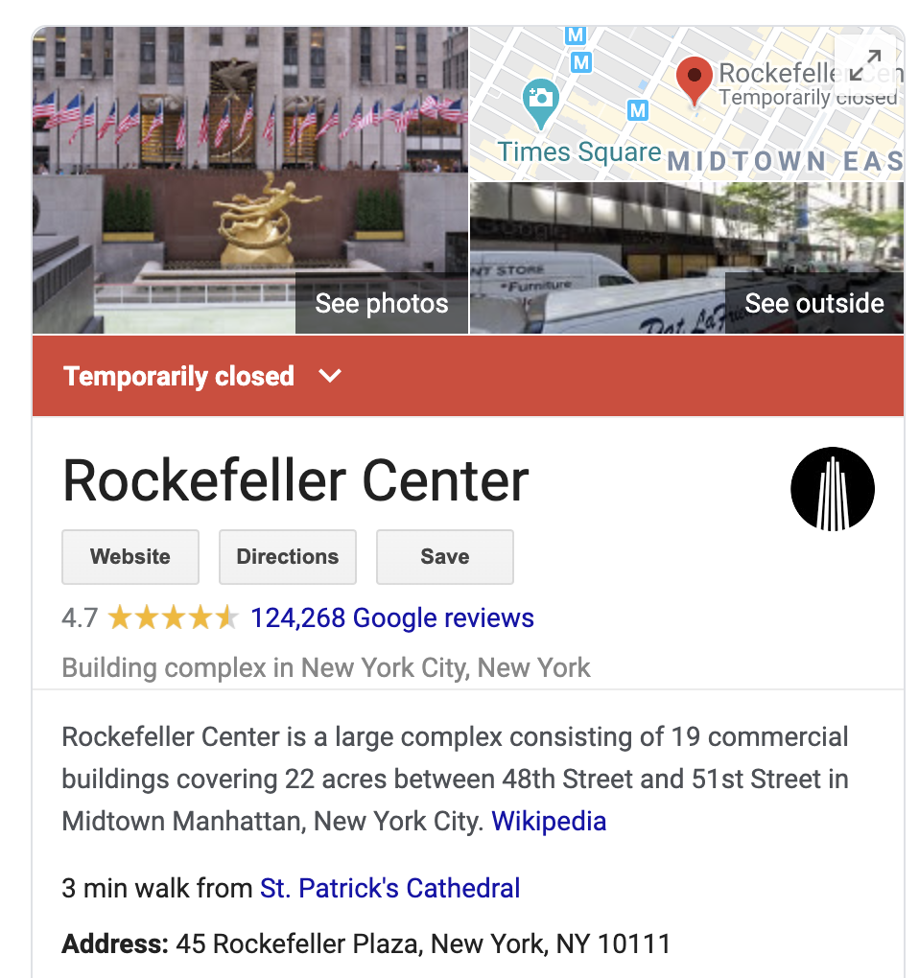
We Made the Highest Priority Updates Quickly
Starting in April, the team made timely changes to help our customers
Updated Our Google
My Business Profile
Now it’s easy for customers
to see our [revised hours, location change, etc.]
Option 1
[Update this screenshot with an example of a change you’ve made]

Slide 4
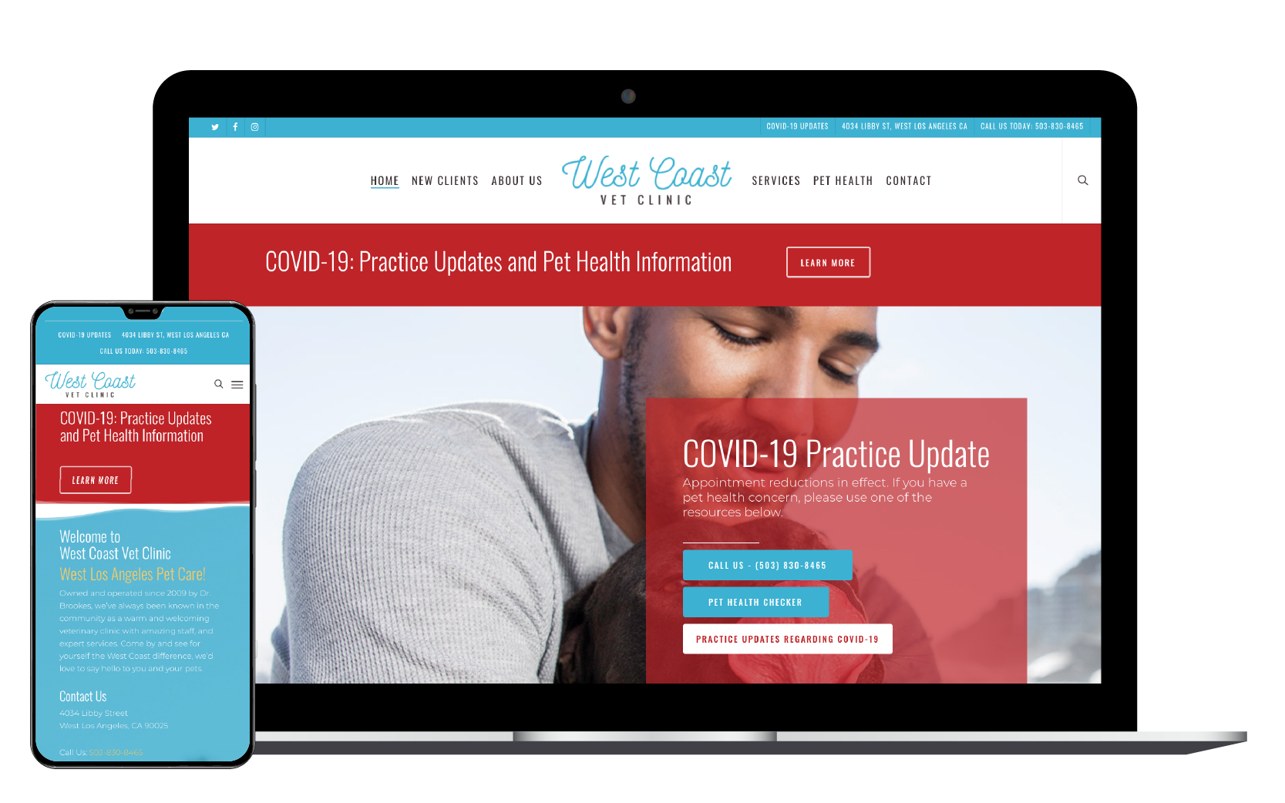
We Made the Highest Priority Updates Quickly
Starting in April, the team made timely changes to help our customers
Created and shared content
[include link] that explains how
we’re responding to COVID 19
  Note: This page has seen XX in
  traffic over the last 2 months
  [add comparison to other pages
  if relevant]
Option 1
[Update this screenshot with an example of a change you’ve made]

Slide 5
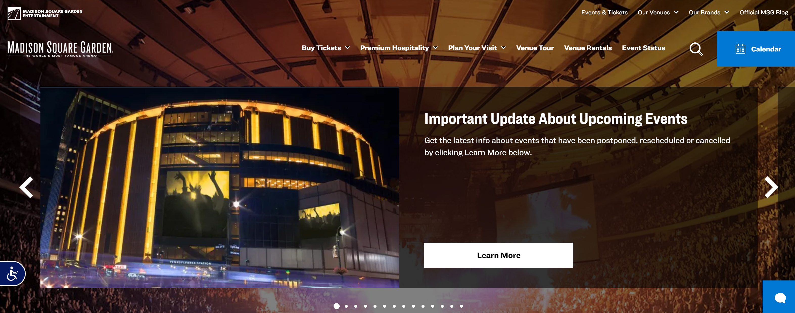
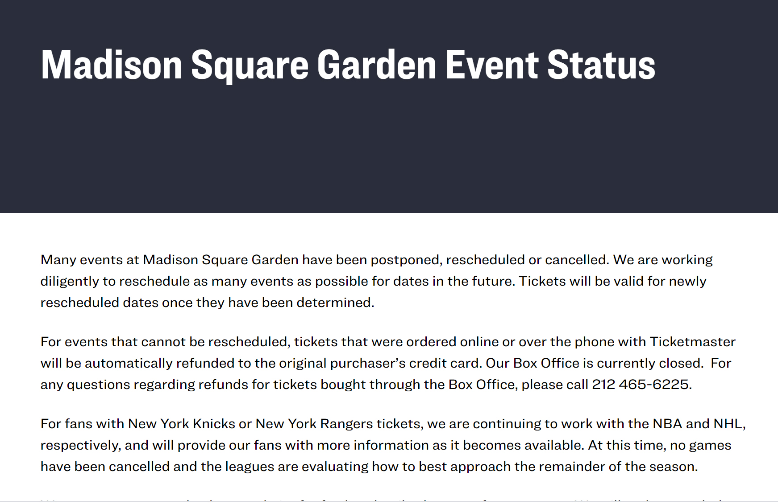
We Made the Highest Priority Updates Quickly
Starting in April, the team made timely changes to help our customers
Updated our events with the latest information
Option 1
[Update this screenshot with an example of a change you’ve made]

Slide 6
We Made the Highest Priority Updates Quickly
Starting in April, the team made timely changes to help our customers
Updated Our Google
My Business Profile
Now it’s easy for customers
to see our [revised hours, location change, etc.]
Created and shared content
[include link] that explains how we’re responding to COVID 19
Note: This page has seen XX in
traffic over the last 2 months
[add comparison to other pages
if relevant]
Updated our events with
the latest information
Option 2

Slide 7
We Made the Highest Priority Updates Quickly
Starting in April, the team made timely changes to help our customers
Google My Business Profile
Updated Events
COVID 19 Response
Option 2

Slide 8
Site Performance Update: [Include a headline summarizing what has happened since March]
[Optional: Use this space to include additional information]
[Use this space to include a screenshot of your reporting, focusing on changes in traffic, leads, or revenue.]

Slide 9
Cross-Channel Win [Update to summarize any big wins you’ve seen with other channels]
[Optional: Use this space to include additional information]
Use this space to include a screenshot of analytics, updated or new content, social engagement, etc.
Partnered with paid search to [launch test, drive traffic to relevant content, adapt to reduced budget], resulting in
[X% increase in visibility,
$X saved budget]
Supported lost paid
traffic and leads by [creating page,
re-optimizing content]
Partnered with social to [launch/update content], leading to [X% increase in page views, X% increase in daily mentions]
Update this section to reflect how you’ve partnered with others.
Option 1 with screenshot to share

Slide 10
Cross-Channel Win [Update to summarize any big wins you’ve seen with other channels]
[Optional: Use this space to include additional information]
Partnered with paid search to [launch test, drive traffic to relevant content, adapt to reduced budget], resulting in
[X% increase in visibility,
$X saved budget]
Supported lost paid
traffic and leads by
[creating page,
re-optimizing content]
Partnered with social to [launch/update content], leading to [X% increase in
page views, X% increase in daily mentions]
Update this section to reflect how you’ve partnered with others.
Option 2 (No Screenshot to share)

Slide 11



Up Next: Changes to Make a Big Impact and Prepare for the Future
WEBSITE UPDATES
KEY PAGE CHANGES
NEW CONTENT
[Improve our site speed
by X seconds, eliminate
X pages of duplicate
content onsite]
[Refresh content on our key pages, Test a new page design for X page]
[Create new content for X opportunities to build
long-term visibility]

Slide 12
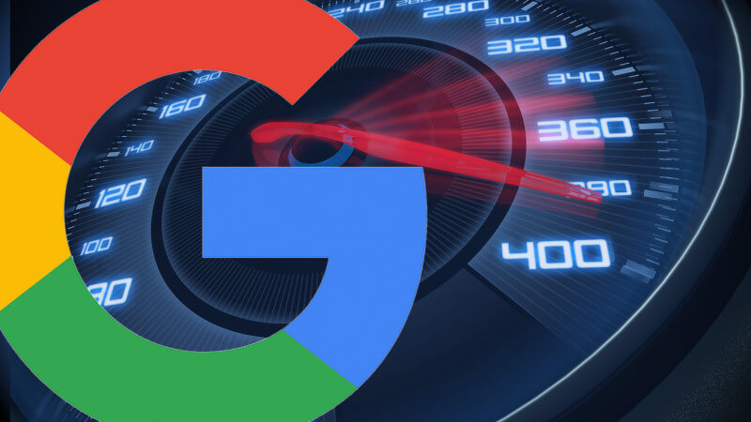
Update Type 1
Option 1
WEBSITE UPDATES
[Optional: Use this space to include additional information]
Since 2018, page speed has been an important ranking factor. We are
X% behind benchmark.
Use this space to include a diagram, example, or screenshot to illustrate your point.
[Include justification/reasoning for your recommendation]

Slide 13
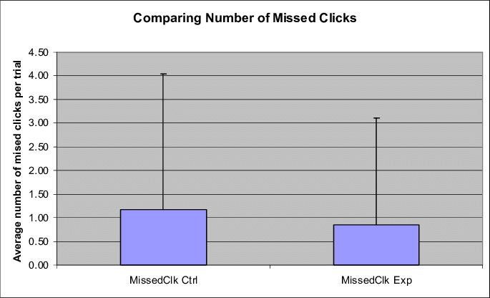
Update Type 1
Option 1
WEBSITE UPDATES
[Optional: Use this space to include additional information]
We haven’t implemented schema onsite yet,
so we don’t own visibility for Events/Shopping, which represents X% missed clicks
Use this space to include a diagram, example, or screenshot to illustrate your point.
[Include justification/reasoning for your recommendation]

Slide 14
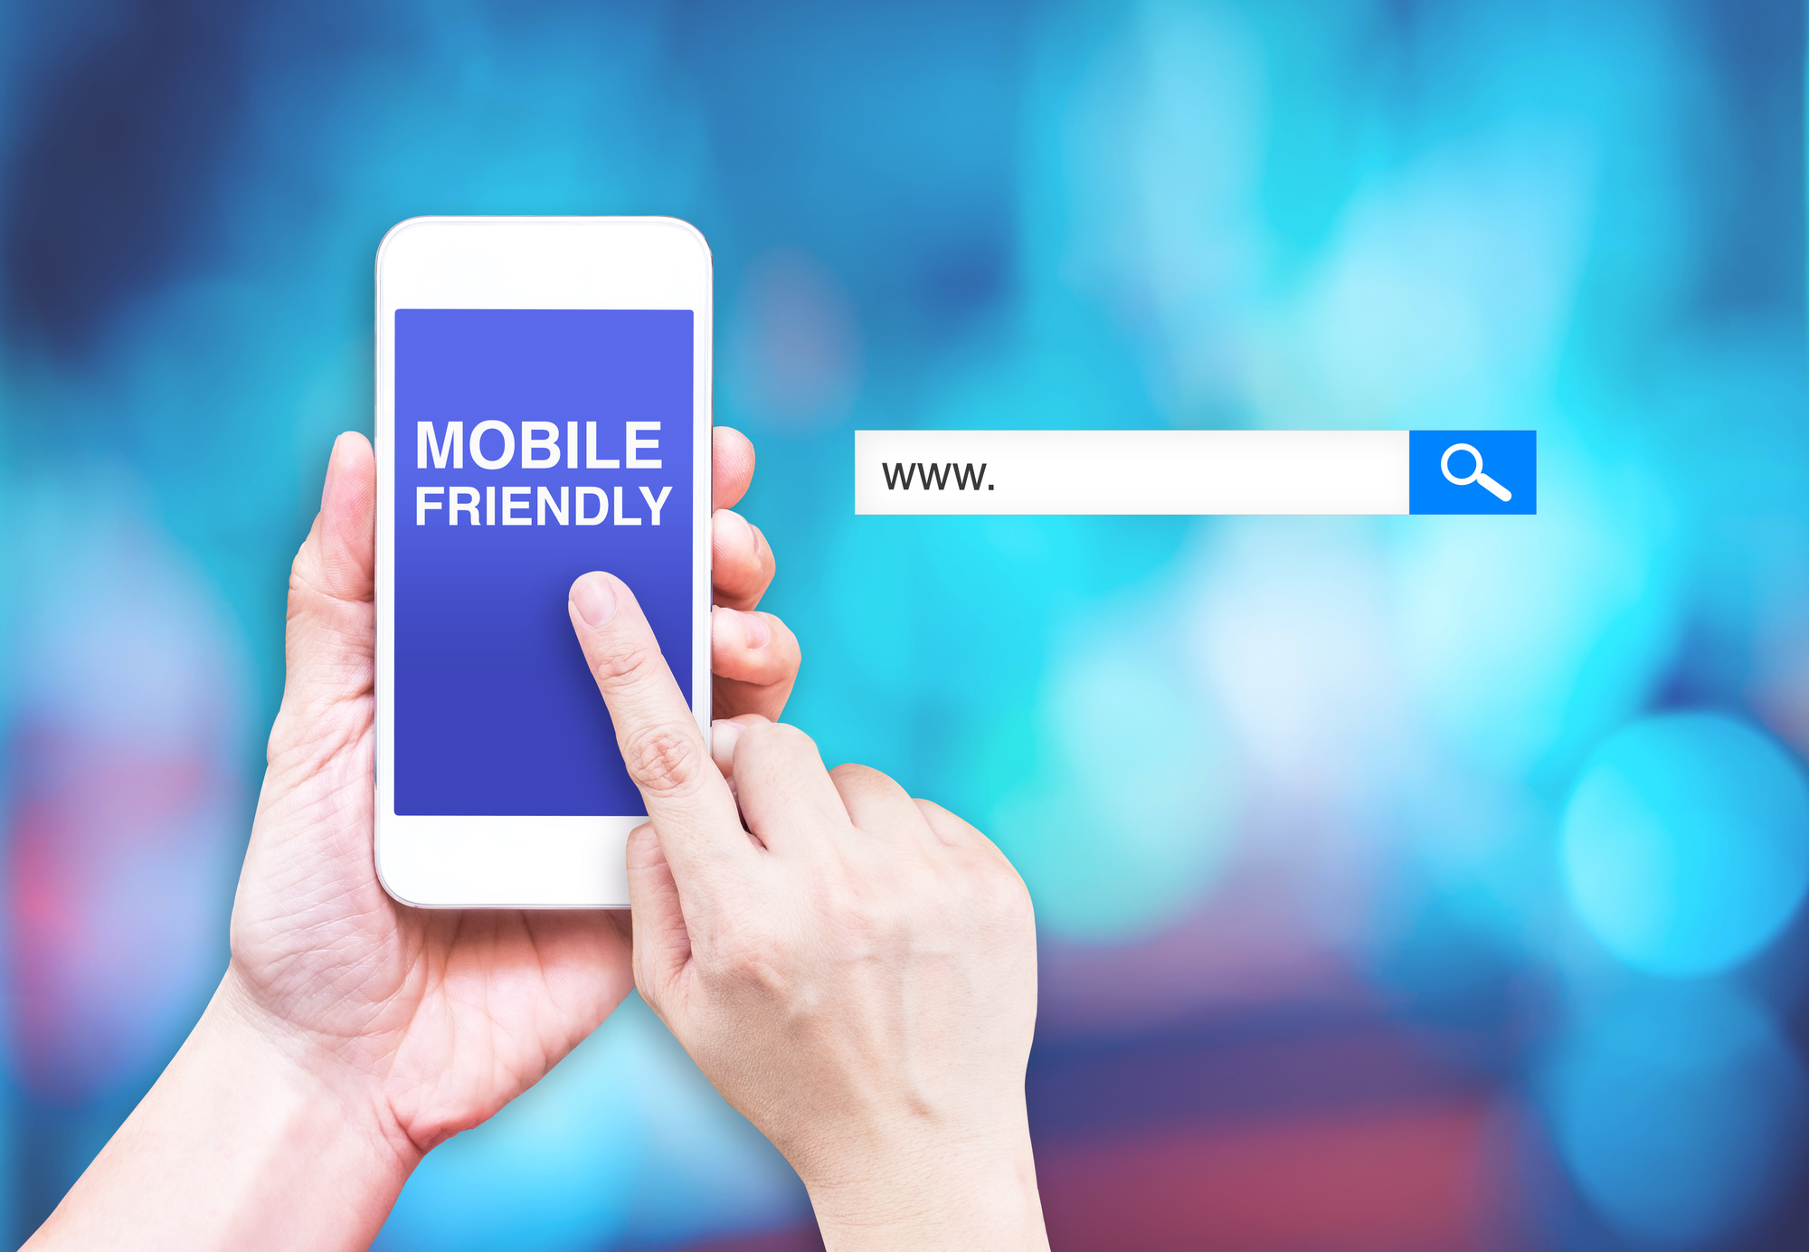
Update Type 1
Option 1
WEBSITE UPDATES
[Optional: Use this space to include additional information]
Our site is mobile-friendly, but we need to improve
X functionality. User experience is increasingly important to Google, and Google has been mobile-first since 2018
Improvements in mobile experience could improve our rankings, increase traffic, etc..
Use this space to include a diagram, example, or screenshot to illustrate your point.
[Include justification/reasoning for your recommendation]

Slide 15
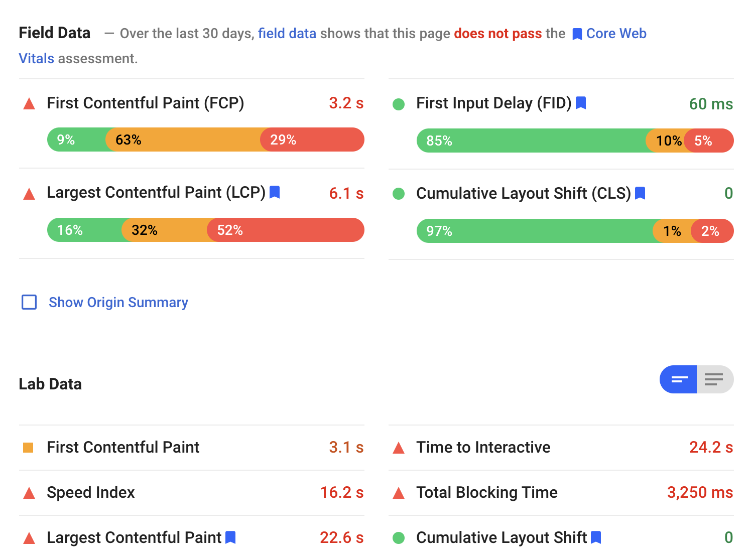
Update Type 1
Option 2
WEBSITE UPDATES
[Optional: Use this space to include additional information]
Use this space to include a diagram, example, or screenshot to illustrate your point.
Since 2018, page speed has been an important ranking factor. We are X% behind benchmark.
We haven’t implemented schema onsite yet,
so we don’t own visibility for Events/Shopping, which represents X% missed clicks
Our site is mobile-friendly, but we need to improve
X functionality. User experience is increasingly important to Google, and Google has been mobile-first since 2018.
Improvements in mobile experience could improve our rankings, increase traffic, etc.
[Include justification/reasoning for your recommendation]

Slide 16
Update Type 2
Option 1
KEY PAGE CHANGES
[Optional: Use this space to include additional information]
Our key pages were last updated in X 20XX. Updating the content and SEO targets for each represents a XX MSV opportunity.
Use this space to include a diagram, example, or screenshot to illustrate your point.
[Include justification/reasoning for your recommendation]

Slide 17
Update Type 2
Option 1
KEY PAGE CHANGES
[Optional: Use this space to include additional information]
Use this space to include a diagram, example, or screenshot to
illustrate your point.
The UX team has been talking about launching a new design, and this is an ideal time to test the concept on X page.
This new concept has improvements in X. Google announced that user experience will be a part of its algorithm in 2021, so we could get ahead of the competition
[Include justification/reasoning for your recommendation]

Slide 18
Update Type 2
Option 2
KEY PAGE CHANGES
[Optional: Use this space to include additional information]
Our key pages were last updated in X 20XX. Updating the content and SEO targets for each represents a XX MSV opportunity.
The UX team has been talking about launching a new design, and this is an ideal time to test the concept on X page.
This new concept has improvements in X. Google announced that user experience will be a part of its algorithm in 2021, so we could get ahead of the competition
Use this space to include a diagram, example, or screenshot to illustrate your point.
[Include justification/reasoning for your recommendation]

Slide 19
Update Type 3
Option 1
NEW CONTENT
[Optional: Use this space to include additional information]
Use this space to include a diagram, example, or screenshot to illustrate your point, such as Conductor’s Result Types.
We don’t rank for [topic], which has X MSV, and [competitive domain] owns X% page 1 visibility.
[Include justification/reasoning for your recommendation]

Slide 20
Update Type 3
Option 1
NEW CONTENT
[Optional: Use this space to include additional information]
Use this space to include a diagram, example, or screenshot to illustrate your point, such as Conductor’s Result Types.
We own about X% of results for [People Also Ask, Answer Boxes, Events] related to X topic. Creating content could lead to [X% increase
in clicks, X% rank improvement]
[Include justification/reasoning for your recommendation]

Slide 21
Update Type 3
Option 1
NEW CONTENT
[Optional: Use this space to include additional information]
We only have X question and answer pieces on our site, whereas [competitor] has X Q&A content, takes the content team X hours to create, is helpful for searchers, and is often leveraged by voice search.
Use this space to include a diagram, example, or screenshot to illustrate your point, such as Conductor’s Result Types.
[Include justification/reasoning for your recommendation]

Slide 22
Update Type 3
Option 2
NEW CONTENT
[Optional: Use this space to include additional information]
Use this space to include a diagram, example, or screenshot to illustrate your point, such as Conductor’s Result Types.
We don’t rank for [topic], which has X MSV, and [competitive domain] owns X% page 1 visibility.
We own about X% of results for [People Also Ask, Answer Boxes, Events] related to X topic. Creating content could lead to [X% increase in clicks, X% rank improvement]
We only have X question and answer pieces on our site, whereas [competitor] has X Q&A content, takes the content team X hours to create, is helpful for searchers, and is often leveraged by voice search.
[Include justification/reasoning for your recommendation]

