Slide 1



The State of AEO/GEO in 2026:
CMO Investment Report
Featuring
insights from:
Aleyda Solís
Founder & International SEO Consultant, Orainti
Eli Schwartz
Author of “Product Led SEO” and Consultant
Lindsay Boyajian Hagan
VP of Marketing & Co-Head of Revenue at Conductor
Greg DiMedio
Head of SEO & AI Search Strategy and Digital Marketing Manager at Taylor Corporation

Slide 2
Table of Contents
Executive Summary
Methodology
AEO/GEO Investments
AEO/GEO Technology
AEO/GEO Strategy
Future State: AEO/GEO in 2026
Summary

Slide 3

Executive Summary

Slide 4
Understanding the Impact of AEO/GEO on digital discoverability
Executive Summary
Generative AI and answer engines have fundamentally redefined how customers discover, evaluate, and build trust in brands, creating a new reality for organizations that rely on digital channels for growth.
As a result, answer engines have quickly become a critical performance channel, signaling which brands AI systems view as credible enough to be included in responses.
Investments are accelerating fast. In 2025, enterprises allocated an average of 12% of their digital budgets to AEO/GEO, and those with high AEO/GEO maturity plan to increase spending at nearly twice the rate of brands with lower maturity in 2026.
The message for executives is clear: If you aren’t investing now, you’re already behind. The good news is brands can still make up ground in AI market share by ramping investments now, but the window is closing fast.
The adoption of AI visibility measurement is rising, but enterprises report that data quality is the top AEO/GEO technology pain point. Scraping-based approaches—fragile, non-compliant, and limited in scope—can’t keep pace as answer engines evolve behind closed interfaces. Enterprises require API-based monitoring that reflects how modern LLMs actually surface information and deliver accurate visibility and ROI attribution.
AEO/GEO isn’t just gaining traction; it’s now the #1 strategic priority for 2026, outpacing paid channels. Forward-thinking executives are leaning in because AI-driven visitors convert at higher rates and in fewer sessions, validating AEO’s impact on revenue. As traditional traffic metrics lose relevance, conversions and revenue attributed to AI visibility are becoming the new primary KPIs.
To help leaders navigate this shift, we surveyed over 250 executives and digital decision-makers to uncover actionable insights, emerging trends, and the investments required to stay competitive in 2026 and beyond.

Slide 5
Top Takeaways
Executive Summary
On AEO/GEO investment:
In 2025, enterprises allocated an average of 12% of digital marketing budgets to AEO/GEO.
56% of organizations reported a high or significant AEO/GEO investment in 2025, and 94% plan to increase investments again in 2026.
High-maturity organizations are the most aggressive, planning to significantly increase AEO/GEO spend at nearly twice the rate of medium-maturity brands in 2026.
  Translation: The gap between leaders and adopters is widening rapidly.
On AEO/GEO resourcing:
Enterprises are investing in internal experts instead of outsourcing. 64% plan to upskill current team members and 29% plan to hire new AEO-specific roles vs. just 7% plan to outsource to an agency or consultants.
This shift reflects a belief that AEO/GEO expertise will become a long-term, in-house competitive advantage.
On AEO/GEO technology:
Data quality was cited as the #1 technology pain point, driven by the limitations of scraping-based approaches. Leaders favor API-based monitoring for reliable AI visibility tracking.
On AEO/GEO strategy:
Adoption and perceived value of AEO/GEO initiatives are high: 92% already track AEO/GEO performance, and 97% reported AEO/GEO had a positive impact on marketing funnels in 2025.
Leaders identified increasing AI visibility as their #1 goal, but also reported generating AI-optimized content at scale is the top challenge, revealing a major execution gap.
ChatGPT contributed the largest share of AI referral traffic, affirming its current role as the primary AI visibility channel.

Slide 6
Methodology

Slide 7
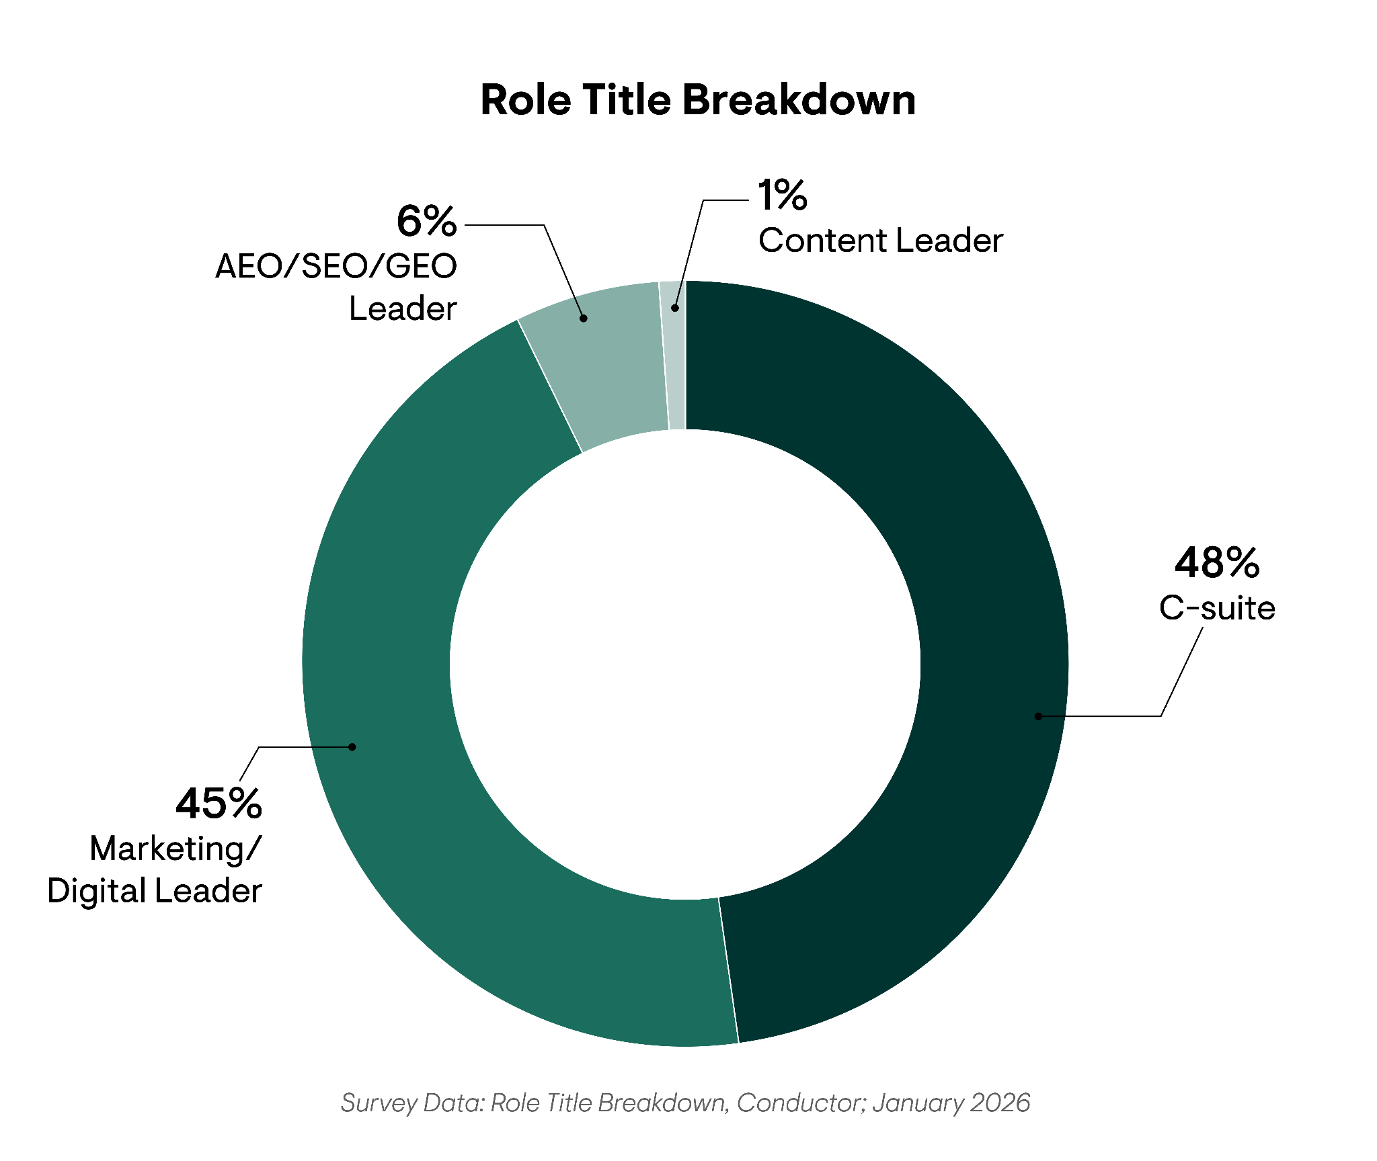
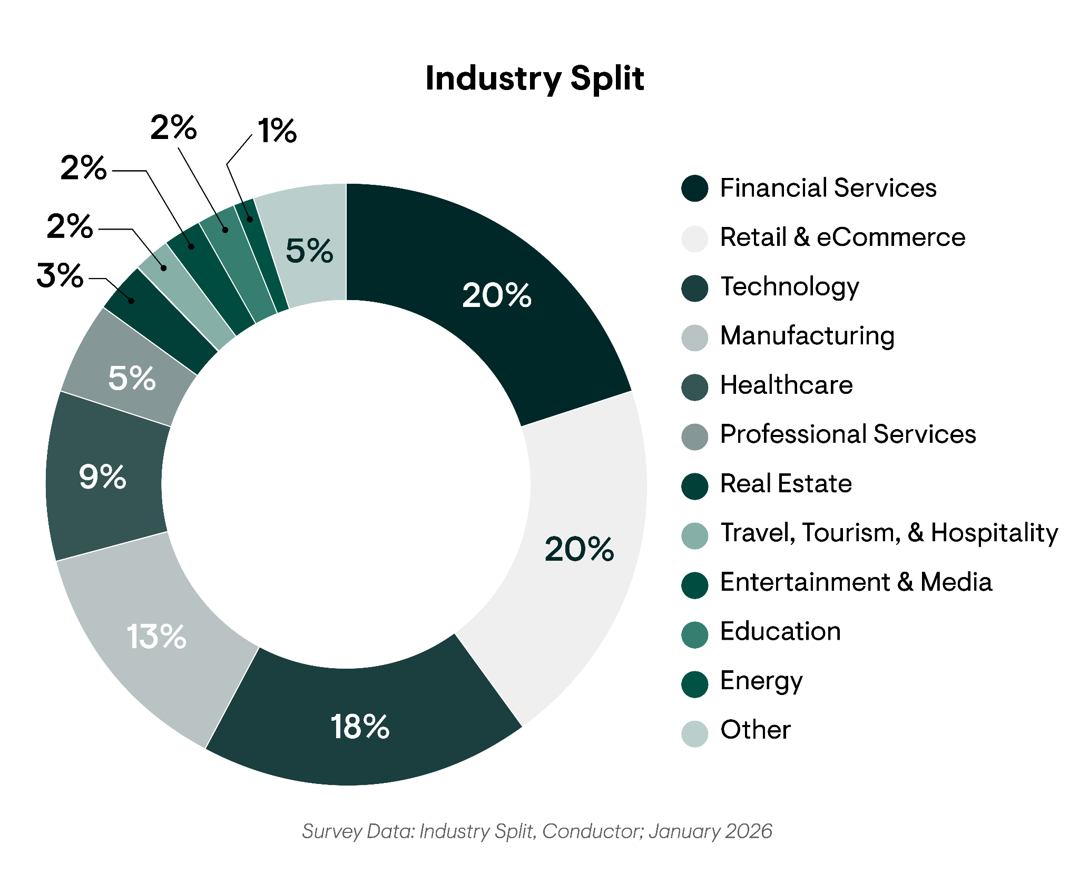
The AEO/GEO Strategy & Investment Report Survey
Methodology
To learn more about the rapidly evolving AI search landscape and the strategies, priorities, and investment plans of today’s top digital executives, we surveyed over 250 executives, digital marketing, AEO/GEO/SEO, and content leaders who manage or oversee AEO/SEO efforts.
Respondents were sourced from enterprise-level organizations (500+ employees) across 12+ industries in the U.S. and have a Sr. Director role or higher.

Slide 8
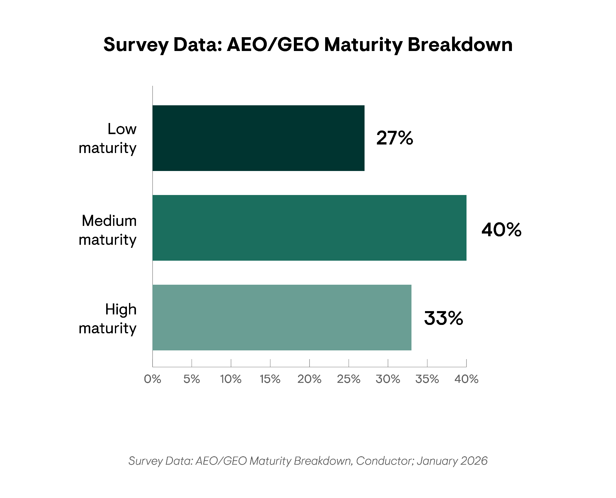
The AEO/GEO Strategy & Investment Report Survey
Methodology
Throughout the report, we speak to the concept of AEO/GEO maturity to further segment the data. Below is a brief overview of the levels respondents could choose from to determine their AEO/GEO maturity:
Low AEO/GEO Maturity: Organizations that are piloting an AEO/GEO initiative, but have so far made limited investments in their strategy.
Medium AEO/GEO Maturity: Organizations where AEO/GEO is integrated into the broader digital marketing strategy with adequate investment.
High AEO/GEO Maturity: Organizations where AEO/GEO is a core digital priority with enterprise-wide adoption and strong investment.

Slide 9
AEO/GEO Investments

Slide 10
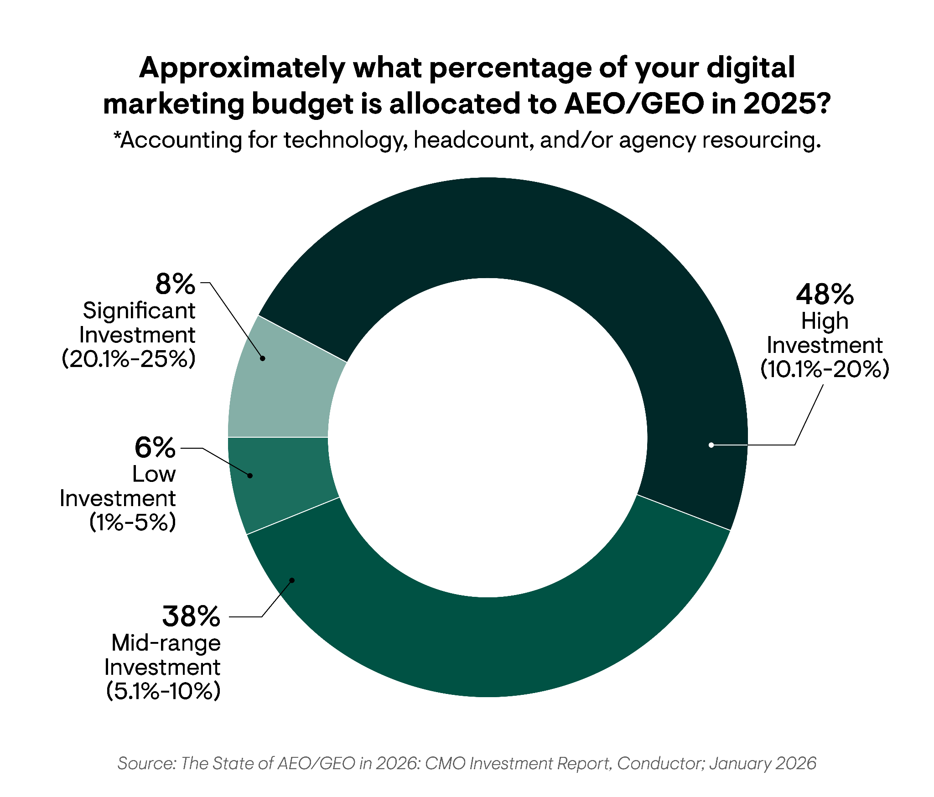
The Percentage of Annual Budget Allocated to AEO/GEO in 2025
AEO/GEO Investments
Overall
56%
reported a high or significant AEO investment in their 2025 budget.

Slide 11
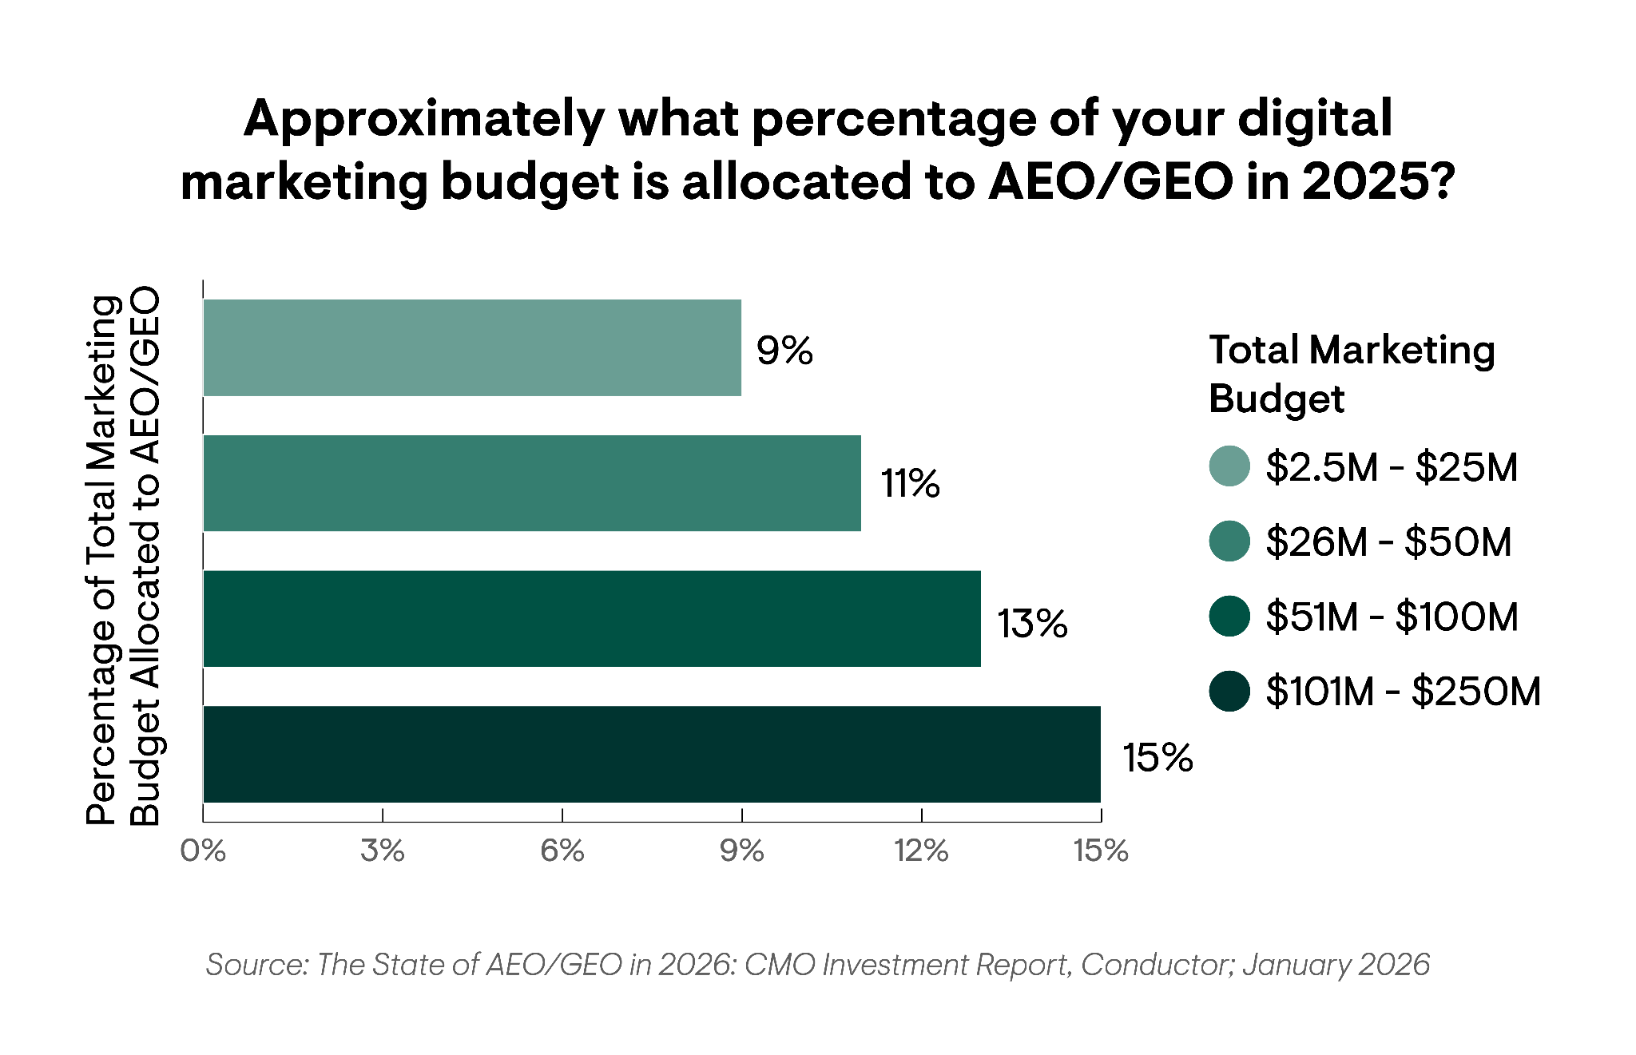
The Percentage of Annual Budget Allocated to AEO/GEO in 2025
AEO/GEO Investments
By Total Marketing Budget
of overall marketing spend is dedicated to AEO/GEO efforts, on average.
12%
Even organizations with smaller marketing budgets are allotting nearly 10% of that overall spend to AEO/GEO.
Additionally, a majority of organizations shared plans to increase their AEO/GEO budget in 2026.
If you’re allotting less than 12-15% of your overall budget to AEO/GEO, you risk falling behind competitors who are committed to securing market share in the new search landscape.

Slide 12
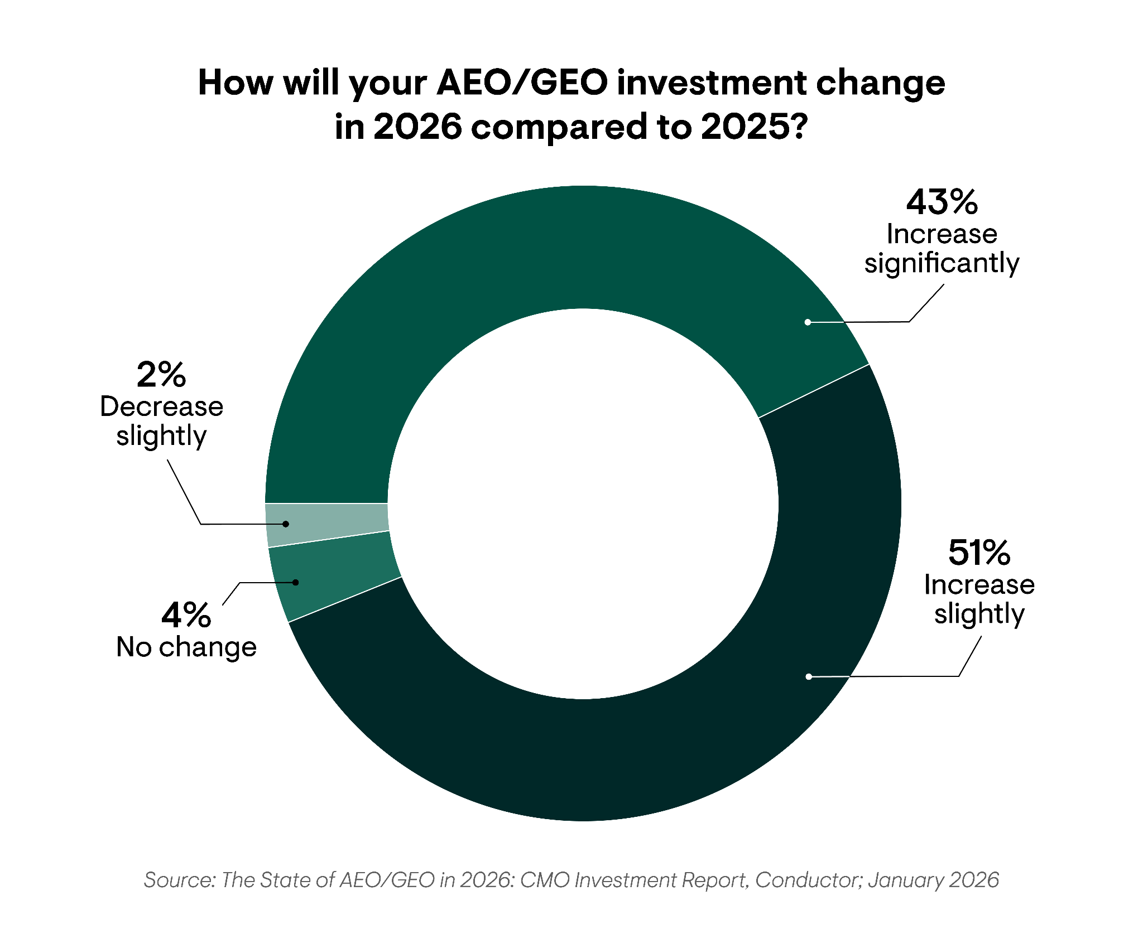
How AEO/GEO Investments Are Changing in 2026
AEO/GEO Investments
Introduction
Overall
94%
plan to increase AEO/GEO investments in 2026.

Slide 13
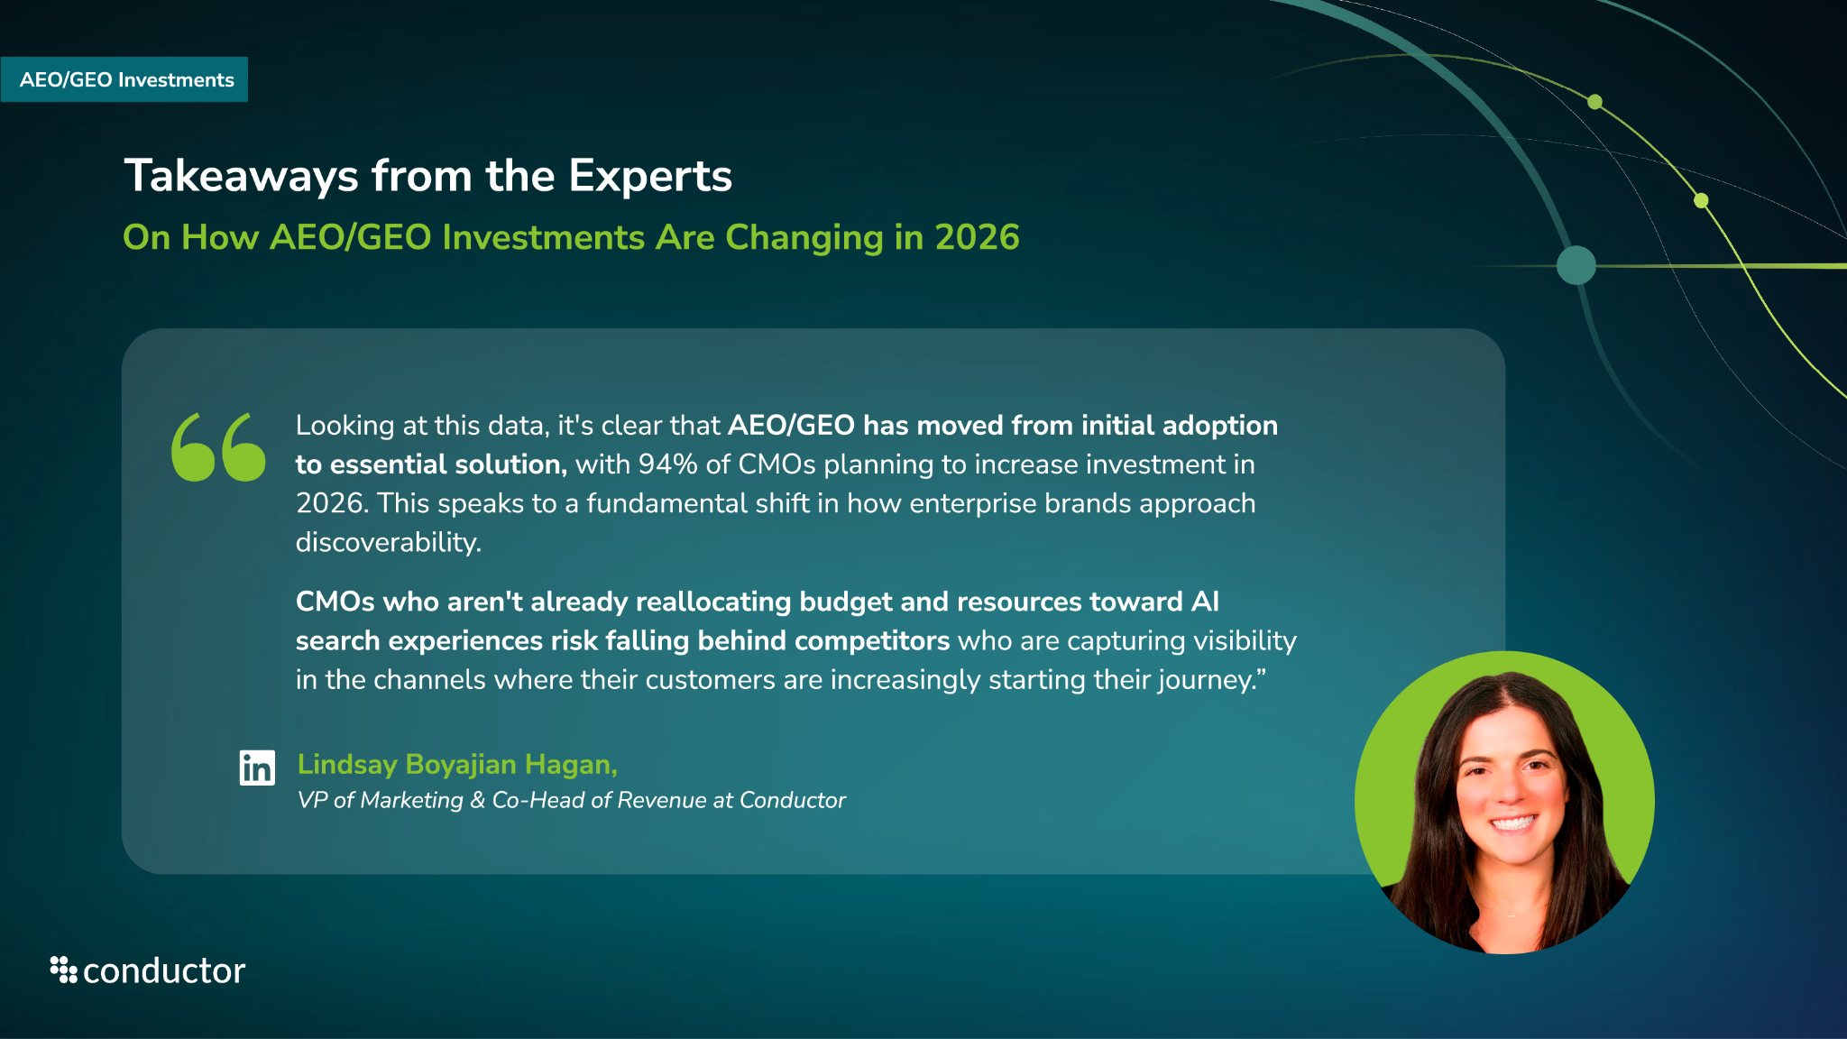


Slide 14
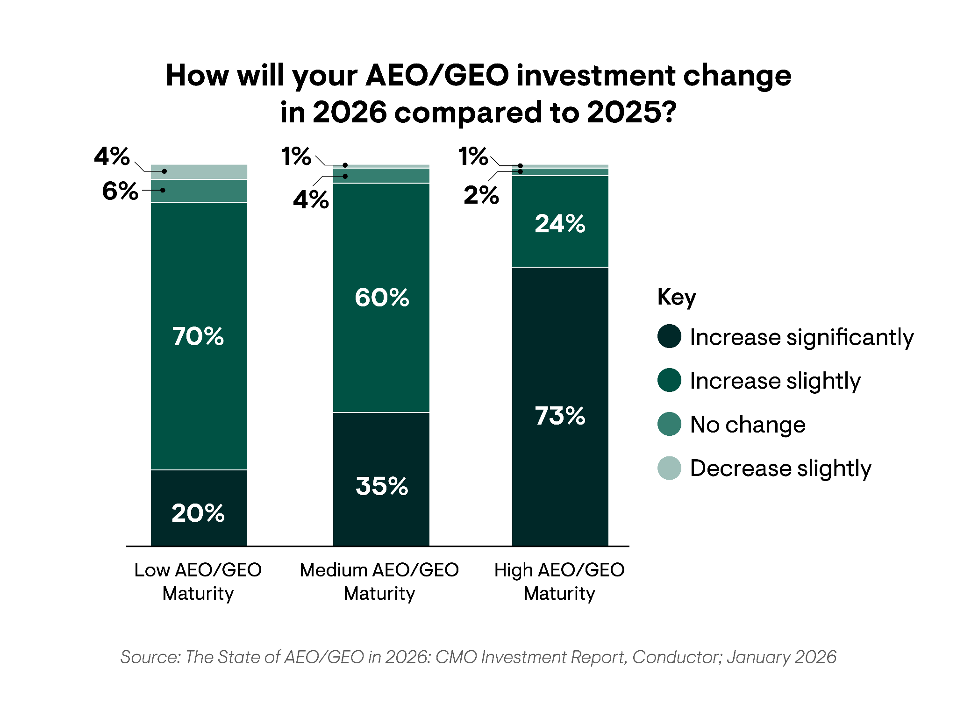
How AEO/GEO Investments Are Changing in 2026
AEO/GEO Investments
By AEO/GEO Maturity Level
High AEO/GEO maturity organizations are 2x as likely as medium maturity orgs and 3x as likely as low maturity orgs to significantly increase AEO/GEO investments in 2026.
Why?
They recognize the value of adopting more advanced and specialized technology to monitor, measure, and optimize AI performance.
They are looking to increase headcount by hiring more hyper-specific AI-focused roles to better understand and optimize AI visibility.

Slide 15
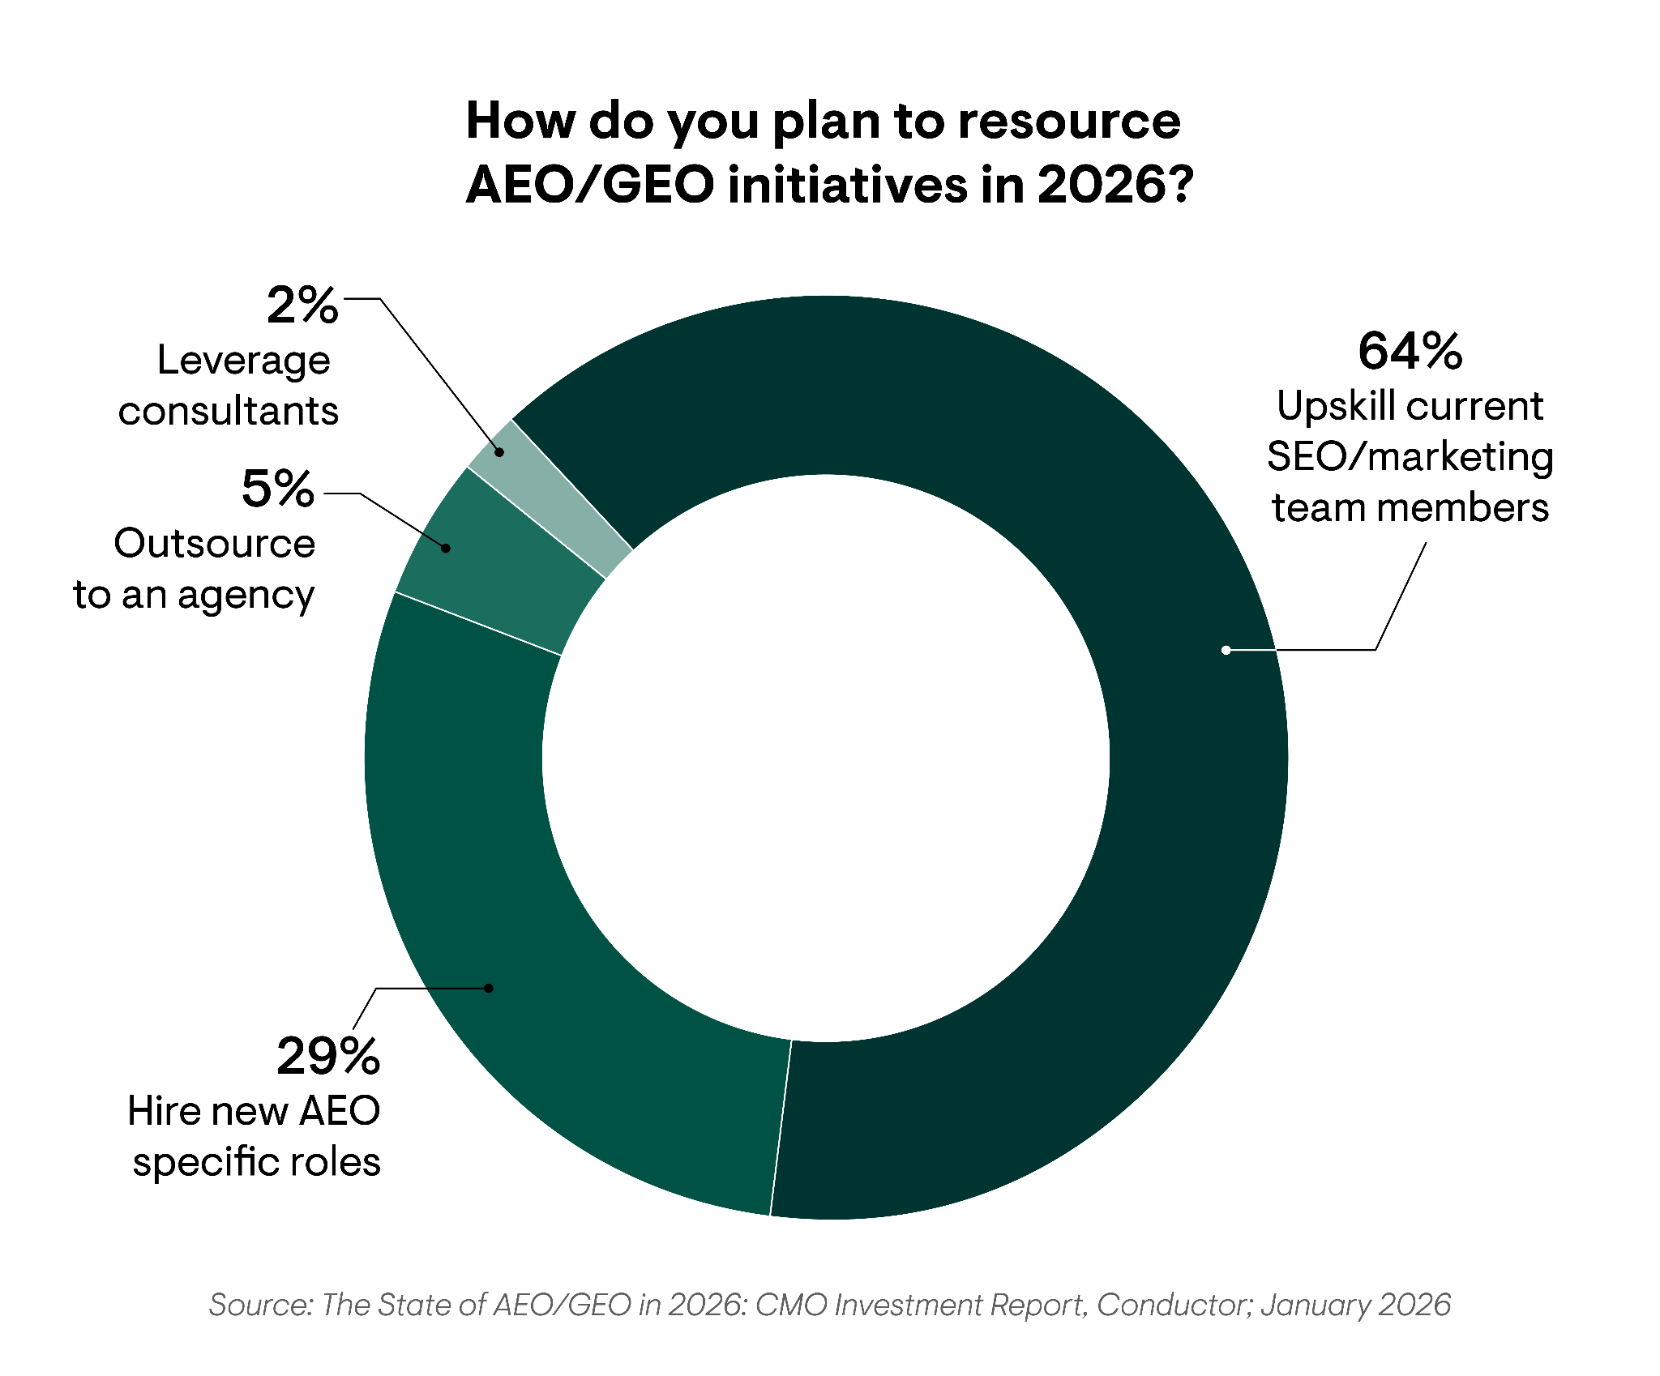
AEO/GEO Resourcing Strategy for 2026
AEO/GEO Investments
Introduction
Overall
When it comes to AEO/GEO resourcing strategies for 2026, enterprise leaders agree that the best resourcing strategy for 2026 is investing internally.
Nearly two-thirds of respondents plan to upskill their current SEO and marketing team members to optimize their AEO/GEO strategy internally.
While one in four plan to hire new, highly specialized AEO/GEO roles.
Why?
Building dedicated in-house AEO/GEO teams ensures organizations can test and iterate faster as AI search surfaces change daily and new disruptions emerge.
This data highlights how enterprise leaders view AEO/GEO as a long-term strategic capability that can provide a competitive advantage when developed internally.

Slide 16
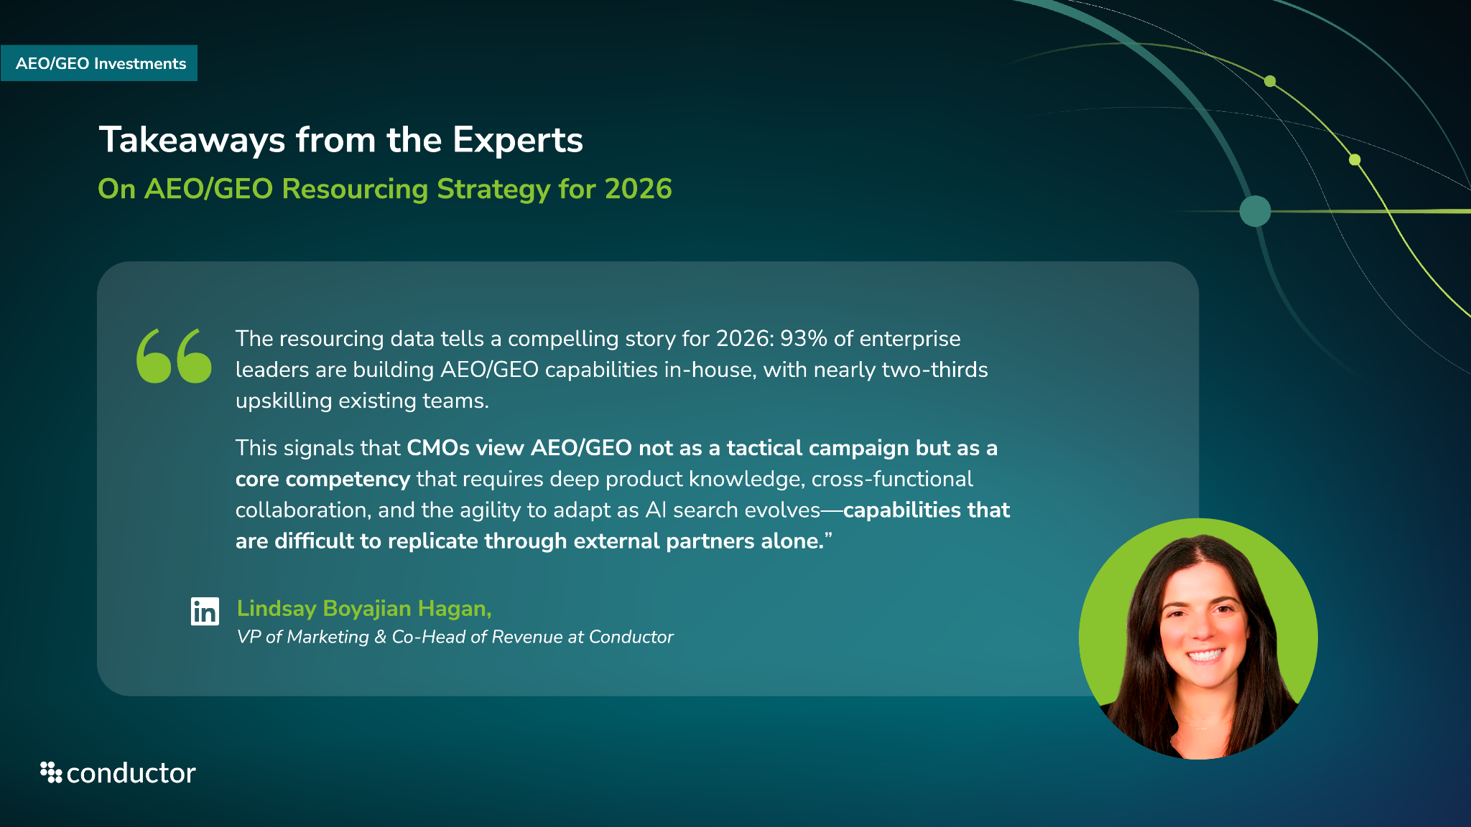

Slide 17
AEO/GEO Technology

Slide 18
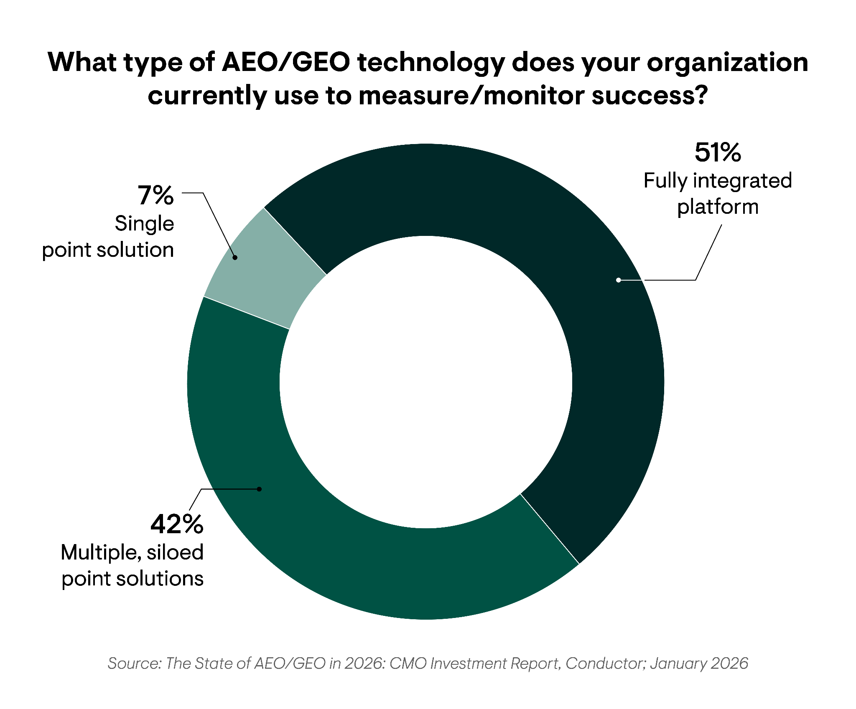
AEO/GEO Technology Use
AEO/GEO Technology
Overall
51%
reported using a fully integrated AEO platform for their AEO/GEO strategy.

Slide 19
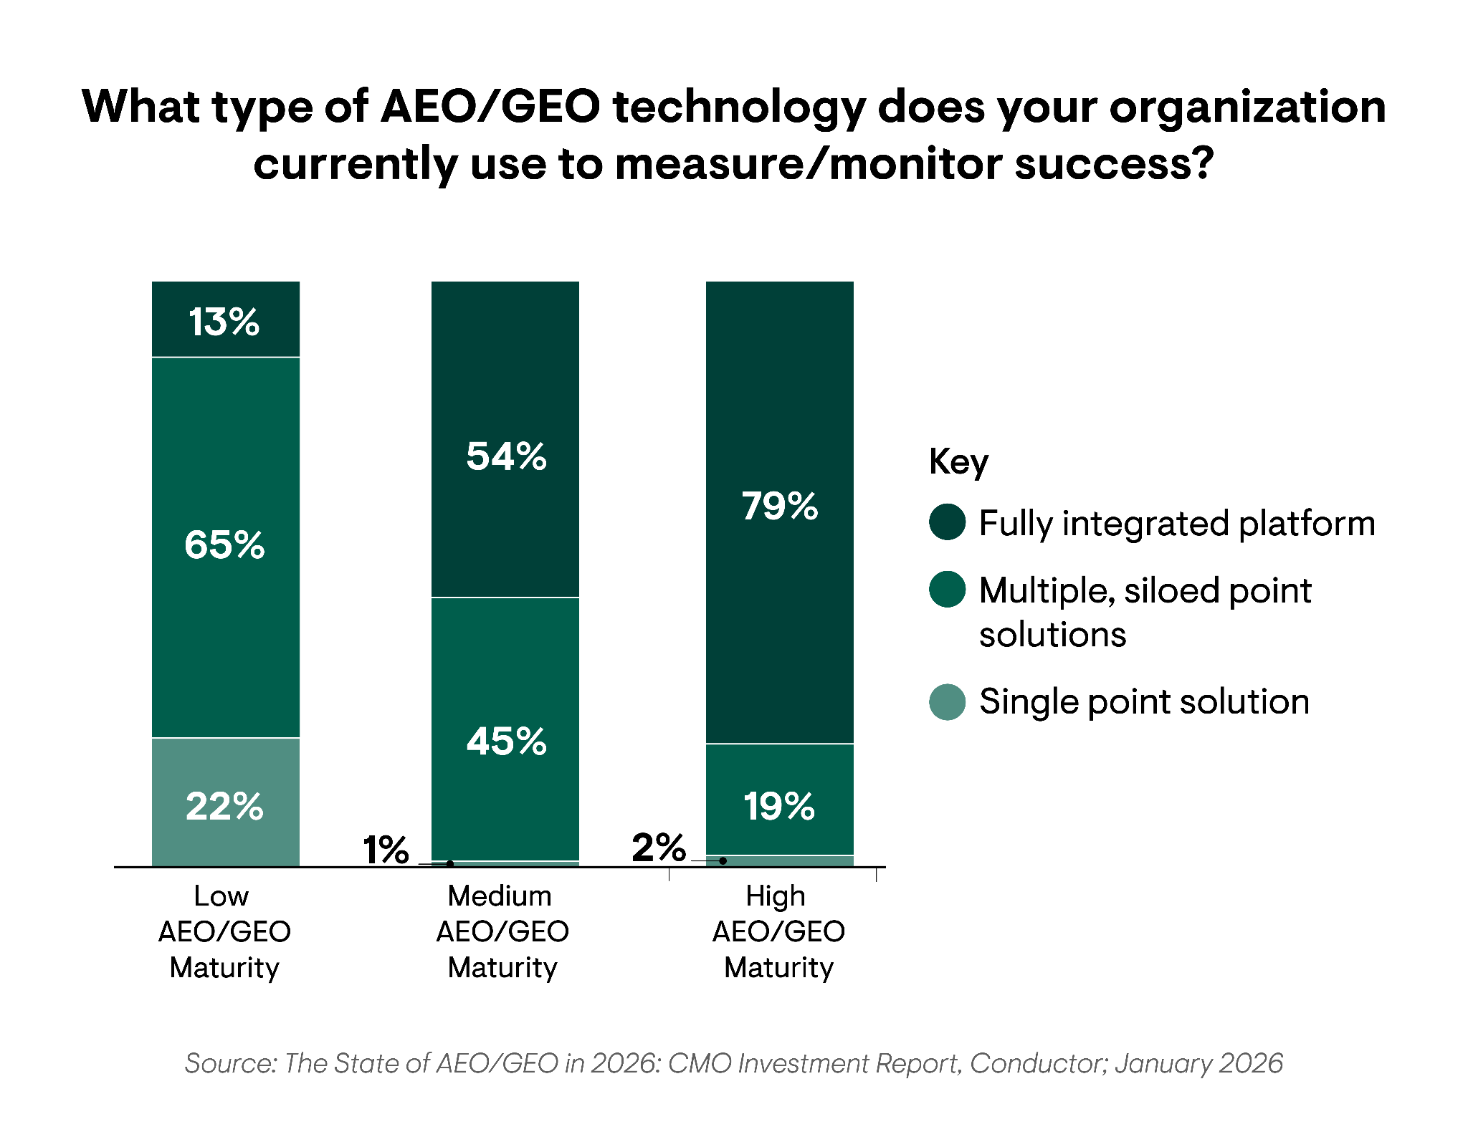
AEO/GEO Technology Use
AEO/GEO Technology
By AEO/GEO Maturity Level
Organizations with high AEO/GEO maturity are about 6x more likely to use a fully integrated platform than a low maturity organization.
Why?
Organizations with high AEO/GEO maturity understand that siloed point solutions can’t provide the monitoring, measurement, and optimization capabilities they need to maximize their AI presence and market share.
Additionally, 100% of respondents reported using an AEO tool of some kind, proving it’s not feasible for enterprise-level organizations to manually measure AEO/GEO performance.

Slide 20
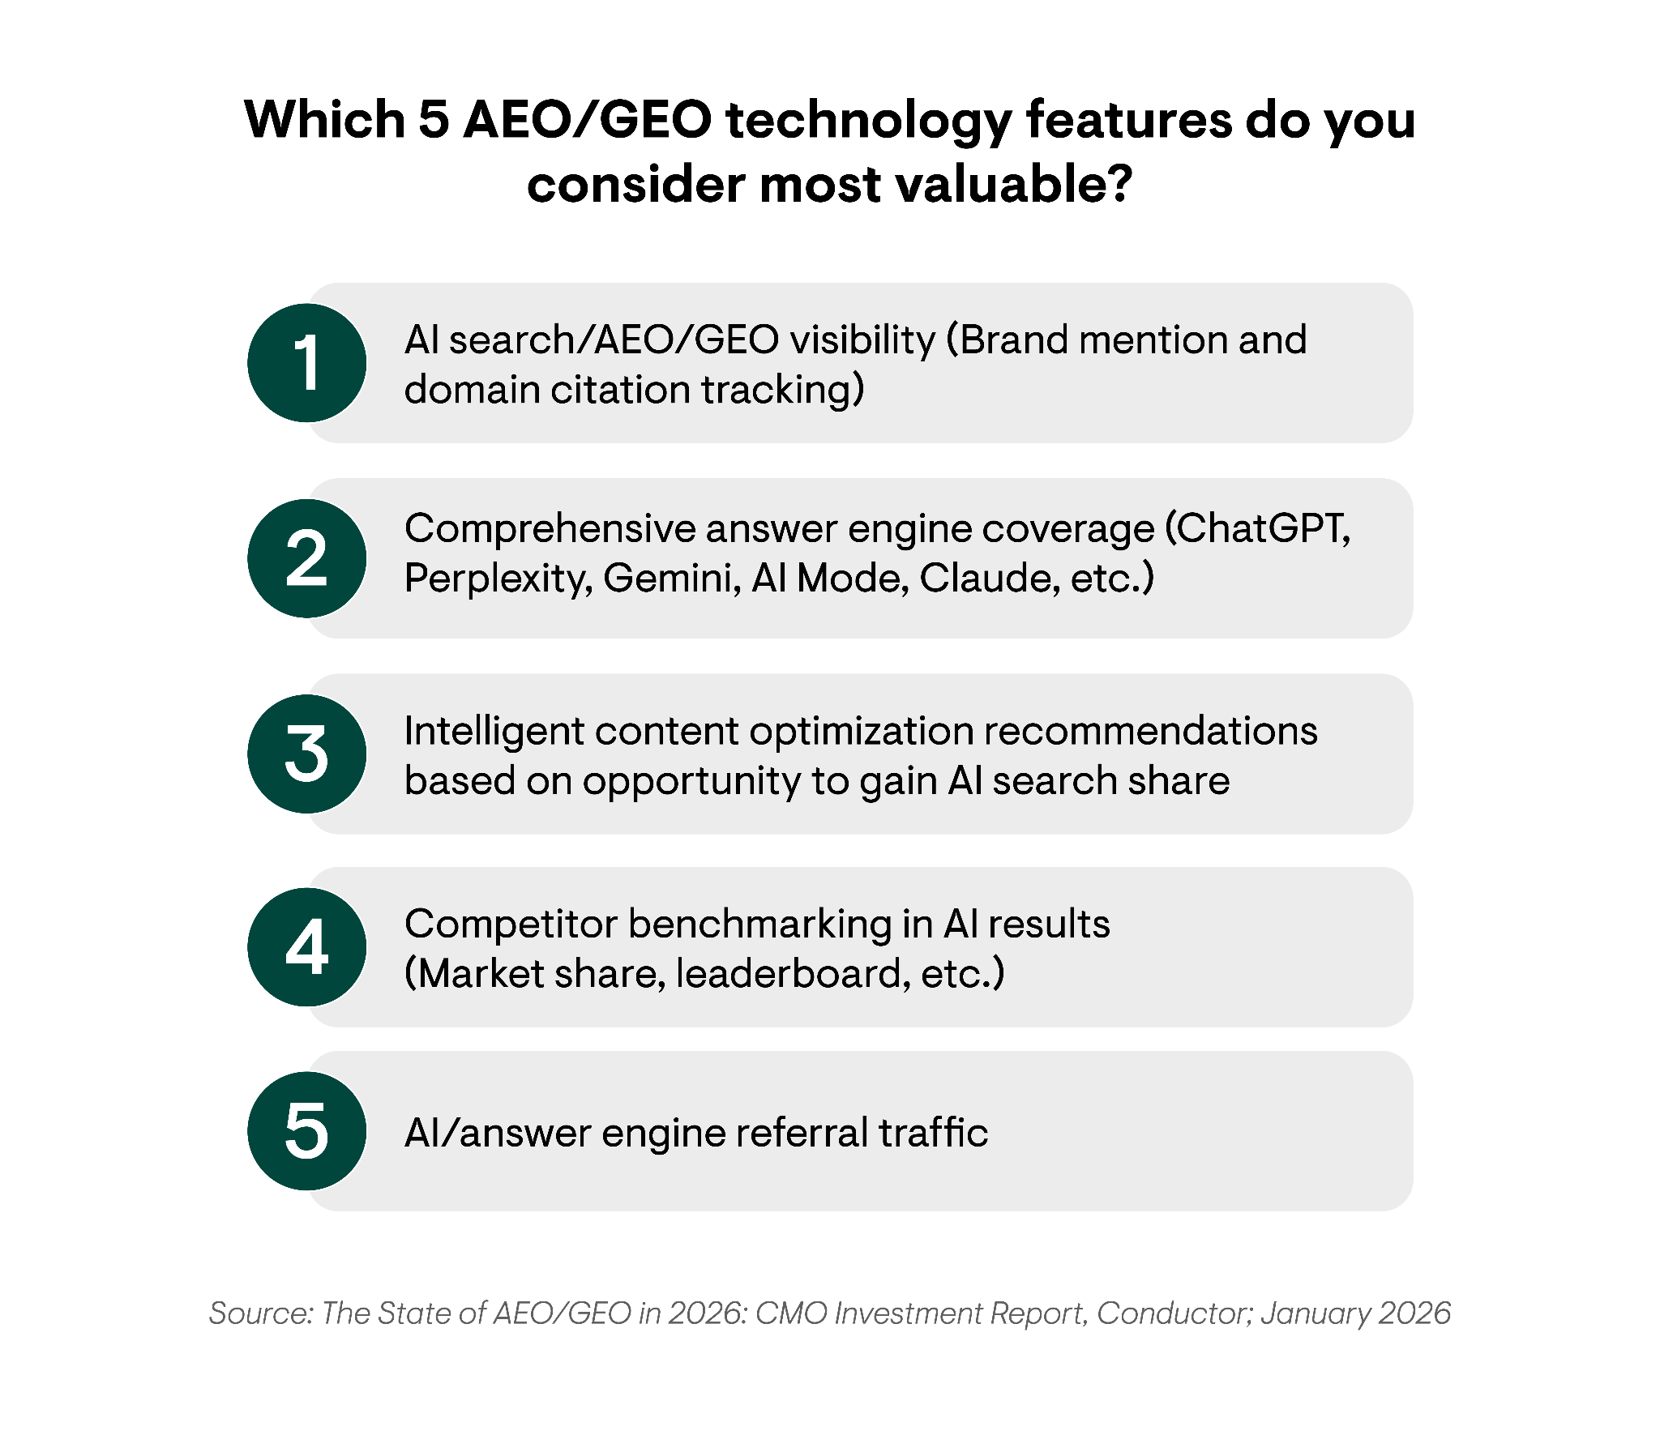
The Top AEO/GEO Technology Features
AEO/GEO Technology
Overall
AI search, AEO, and GEO visibility tracking ranked as the #1 most valuable technology feature.
When it comes to AEO/GEO technology, CMOs and digital leaders value features that allow them to measure their brand’s AI visibility. The best way to benchmark that visibility is with brand mentions and domain citations in AI search.
But cultivating strong AI visibility in one LLM isn’t enough to sustain success; organizations need to appear in mentions and citations across the ecosystem to maximize their presence. That’s why coverage across answer engines was ranked the second most valuable feature.

Slide 21
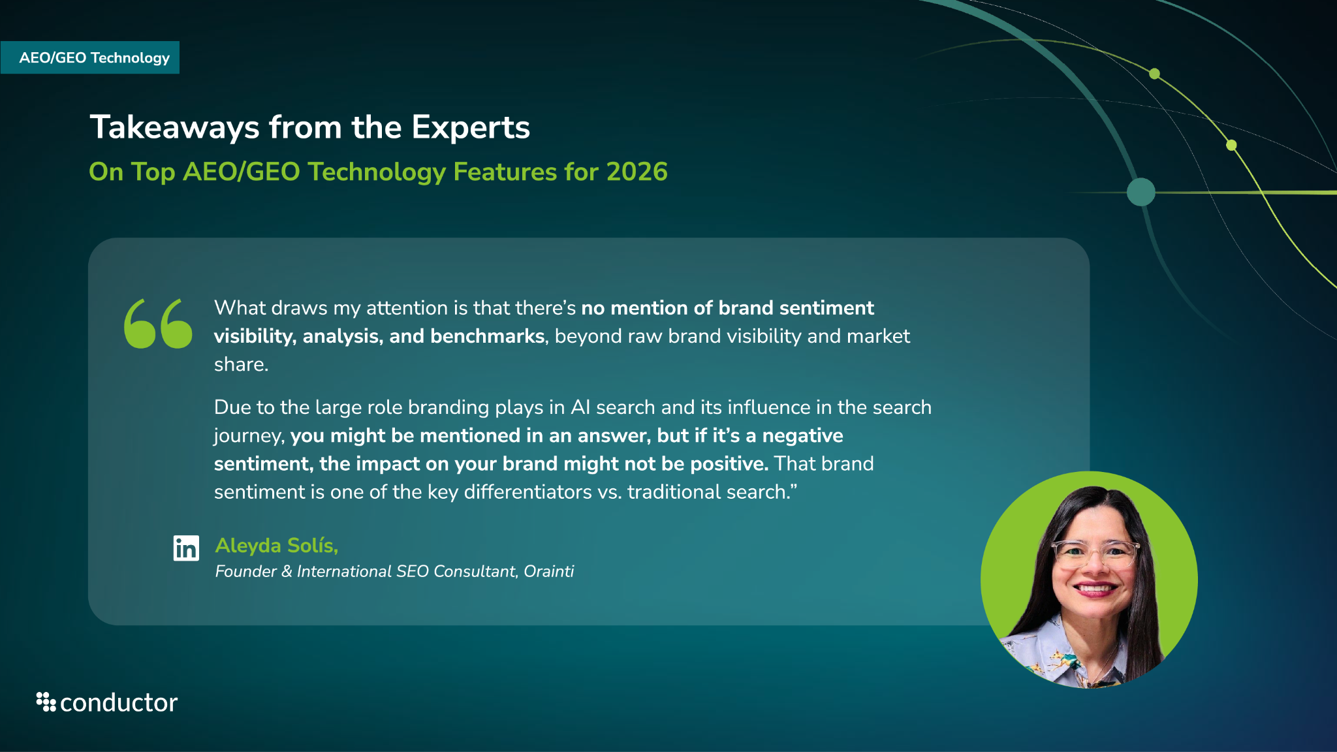

Slide 22
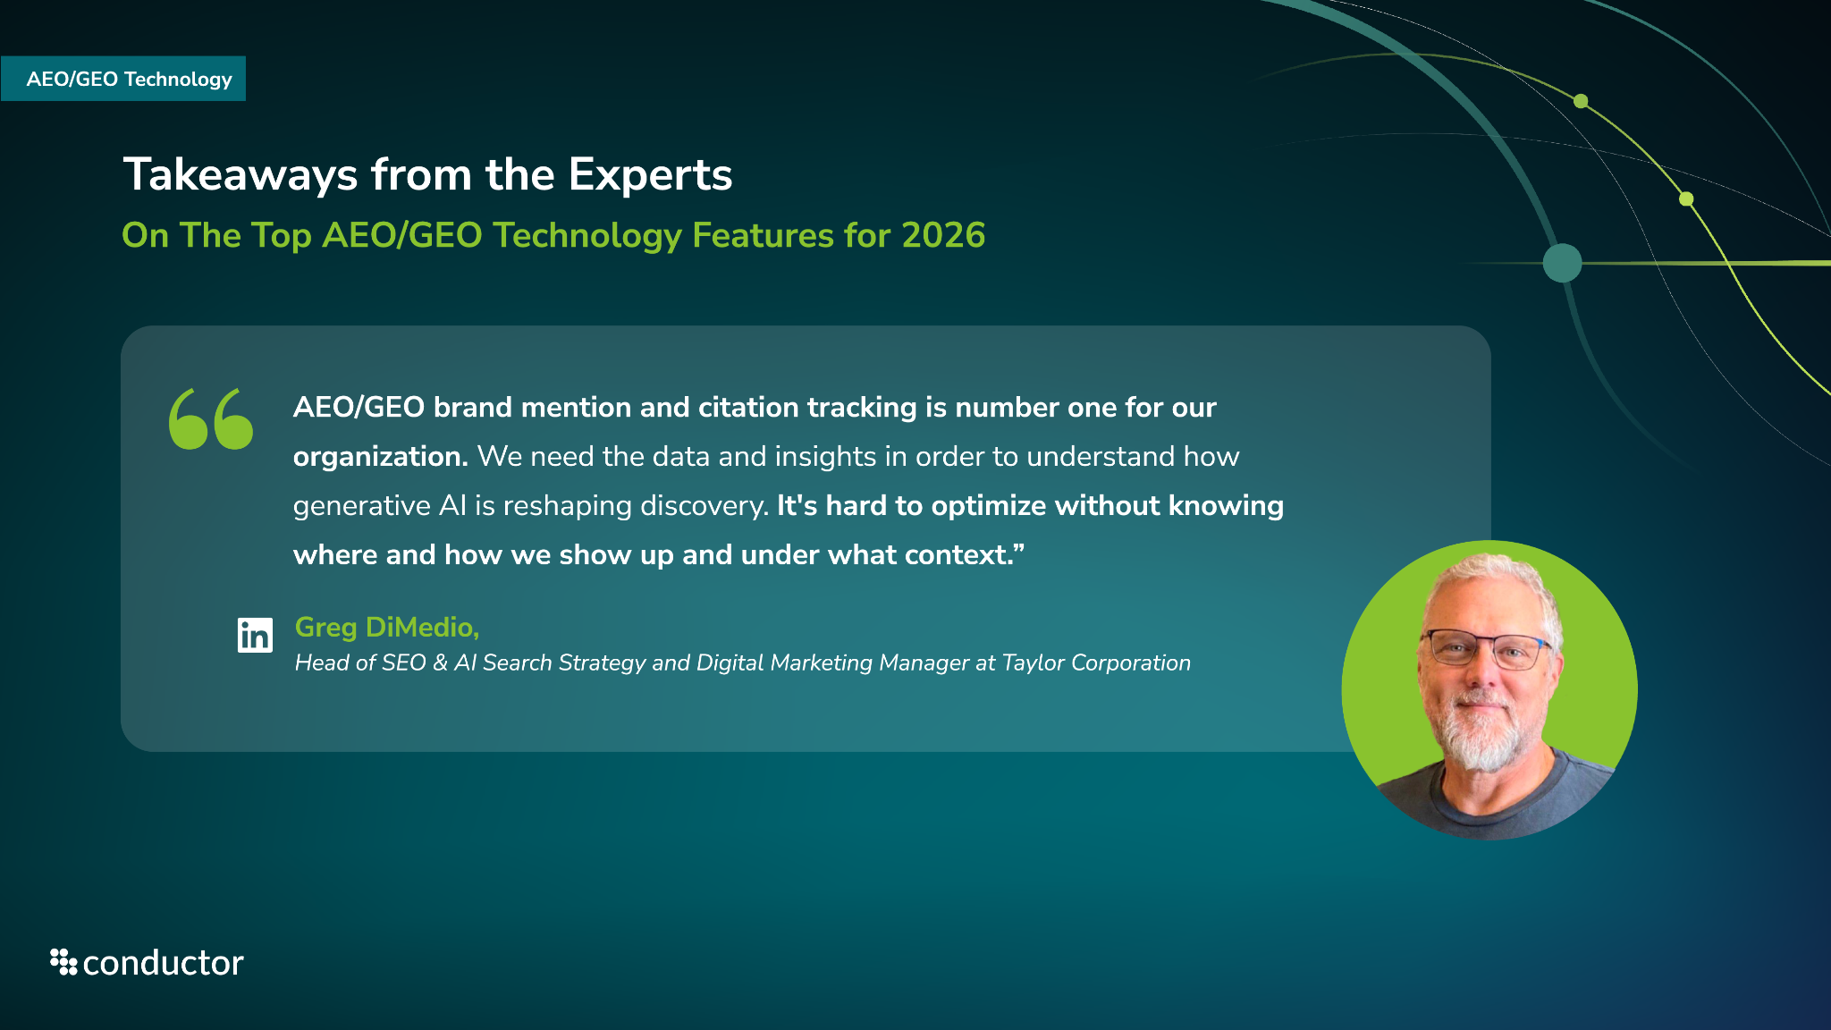

Slide 23
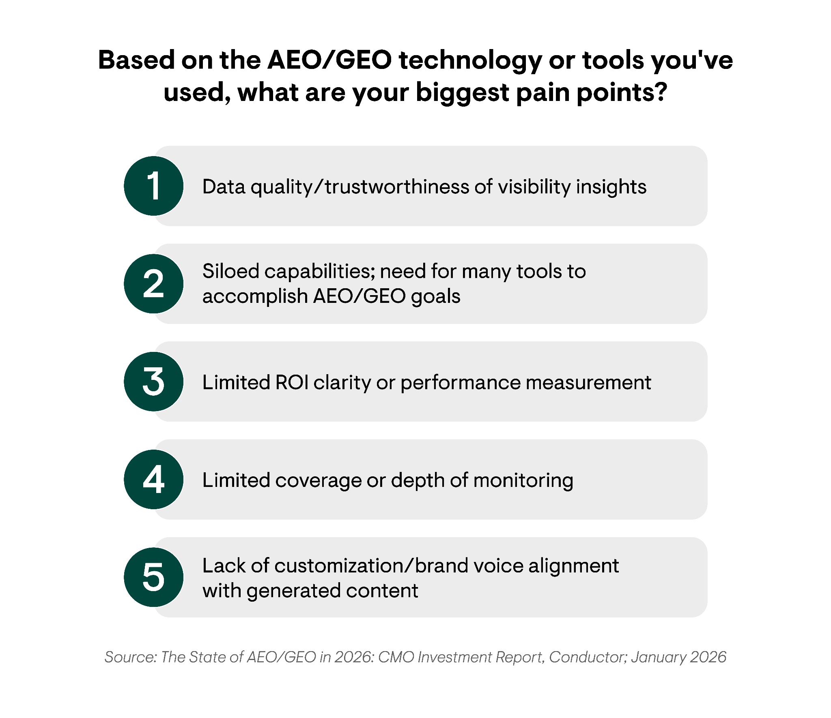
The Top AEO/GEO Technology Pain Points
AEO/GEO Technology
Overall
Respondents were split between data quality/the trustworthiness of visibility insights and siloed AEO/GEO tools & capabilities as their biggest AEO/GEO technology pain points, followed closely by limited ROI.
When data isn’t trustworthy, and AEO/GEO tools are siloed, it becomes impossible to accurately attribute revenue and prove ROI. That’s why leveraging a unified platform is so critical for enterprises, it establishes the data credibility needed to confidently understand performance and invest in optimization initiatives.

Slide 24
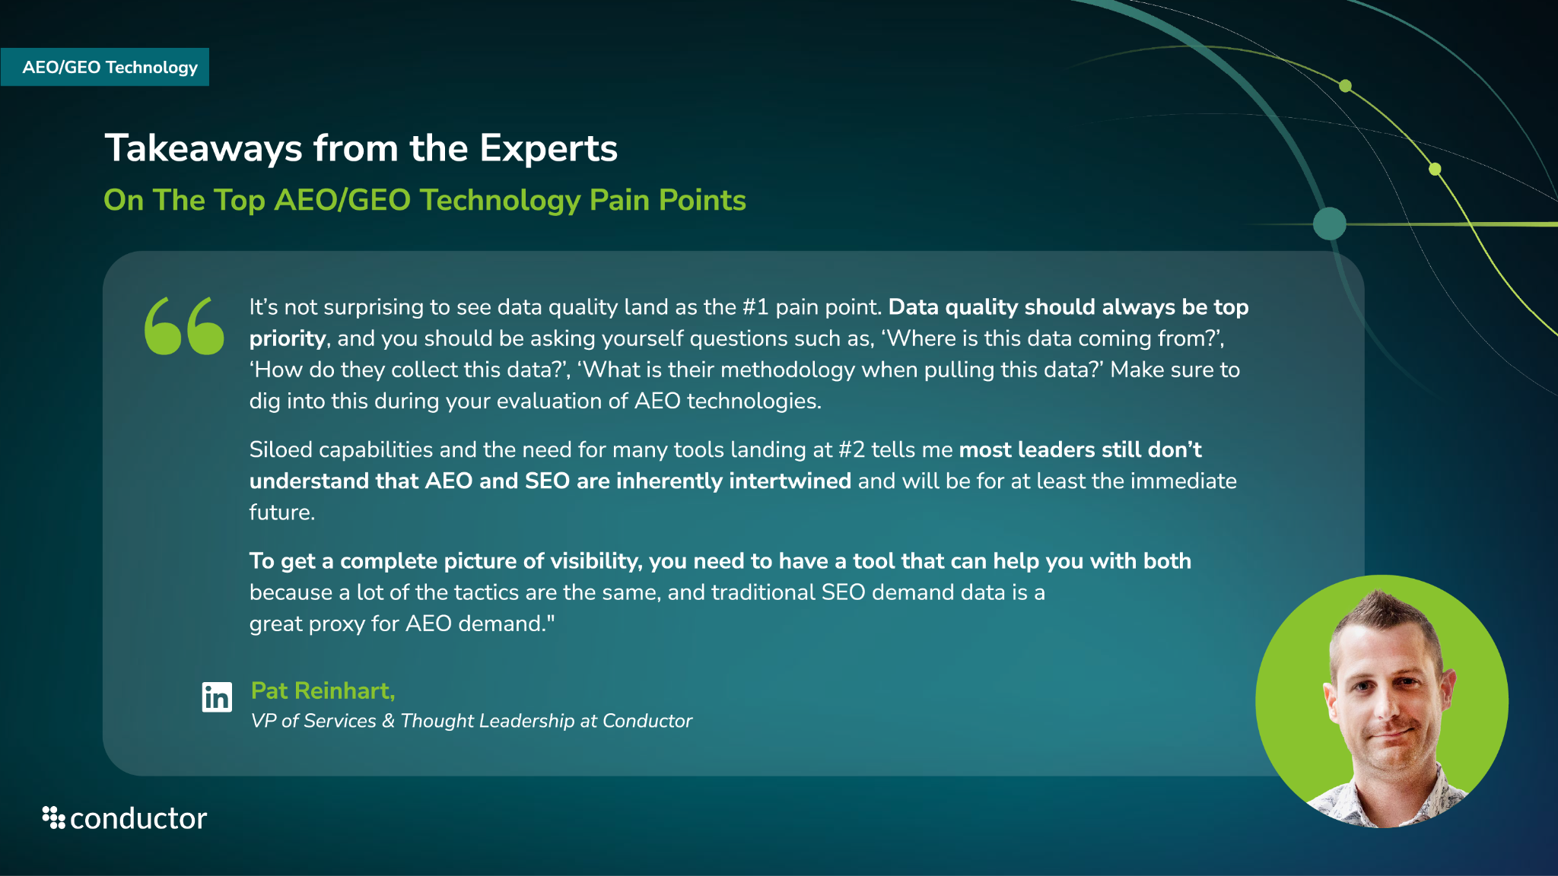

Slide 25
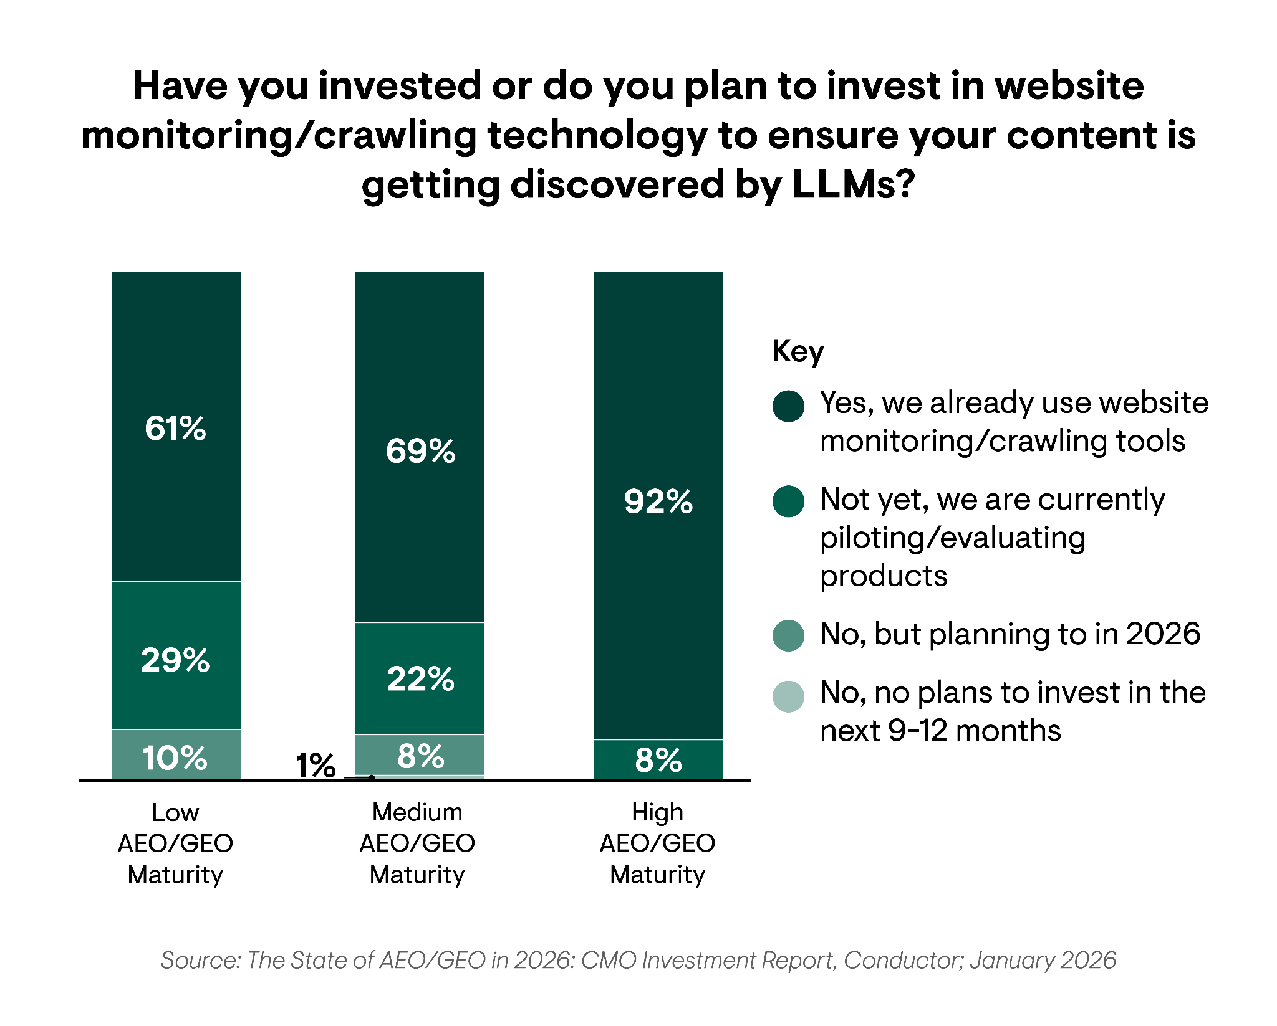

AEO/GEO Monitoring & Crawling Technology Use
AEO/GEO Technology
By AEO/GEO Maturity Level
Organizations with high AEO maturity are more likely to already be using a website monitoring/crawling solution.
Manual crawls aren't practical for enterprise organizations, especially with the rate at which AI crawls and recrawls content. Today, organizations need to know if there are issues on their site ASAP to ensure bots can access their content or risk their AEO/GEO performance.
If LLMs run into technical issues while accessing your content, they’re unlikely to cite you, making that content essentially invisible in AI search. That’s why 24/7 monitoring is the best way forward for brands looking to protect their AI visibility.
Monitor every page of your site for technical issues with 24/7 website monitoring.
Try for free

Slide 26
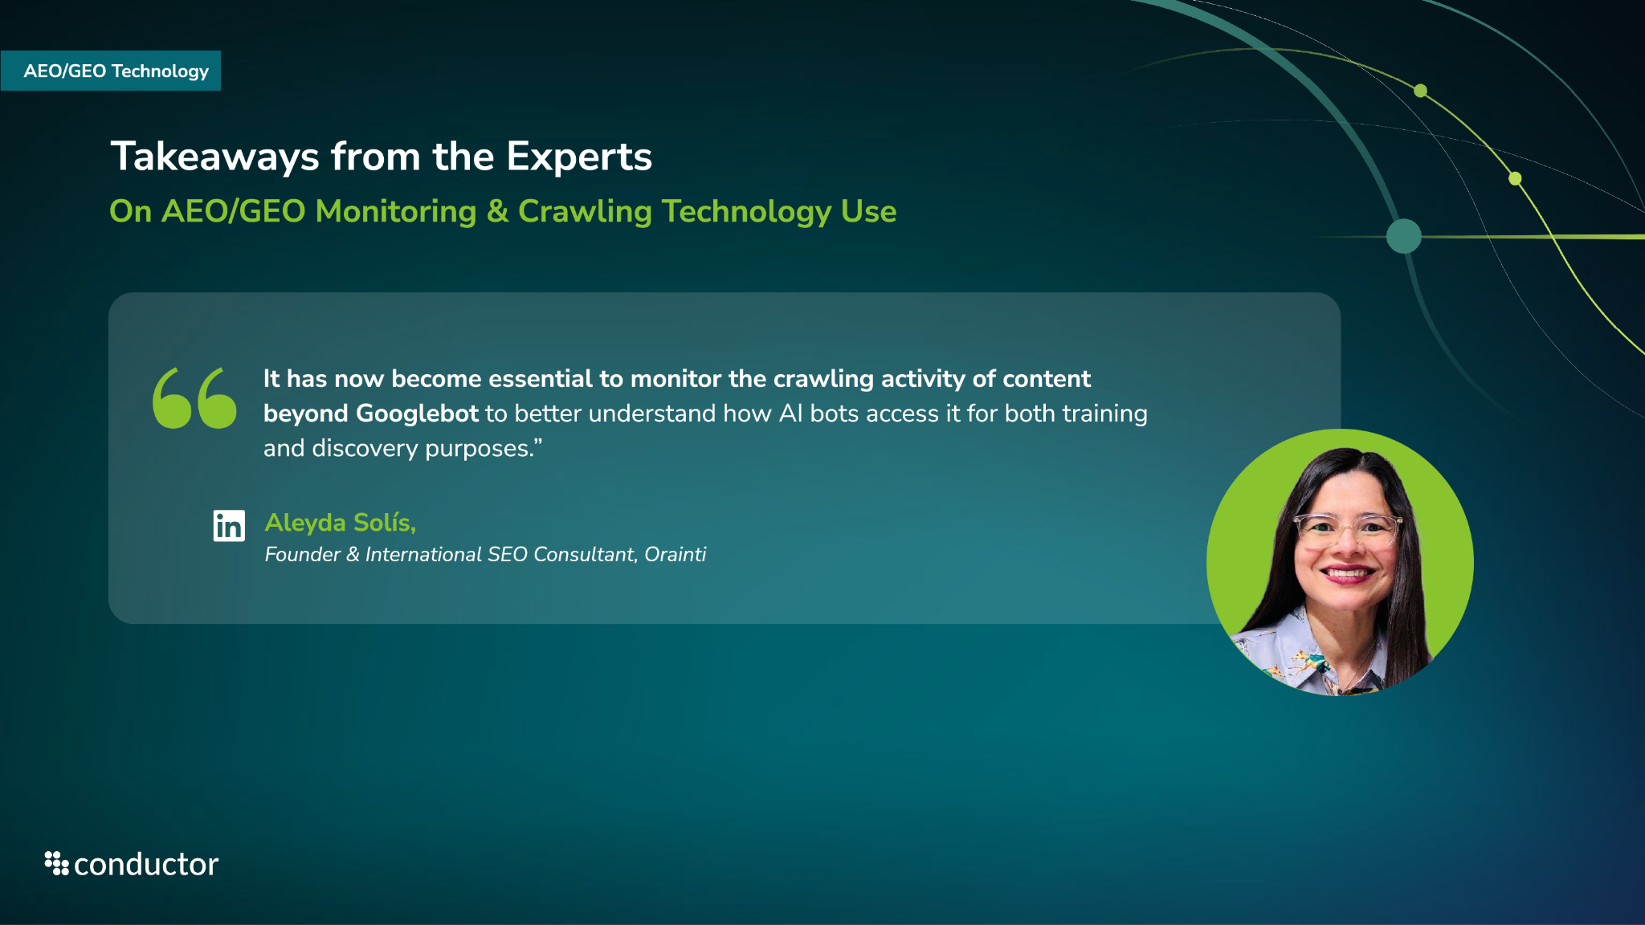

Slide 27
AEO/GEO Strategy

Slide 28
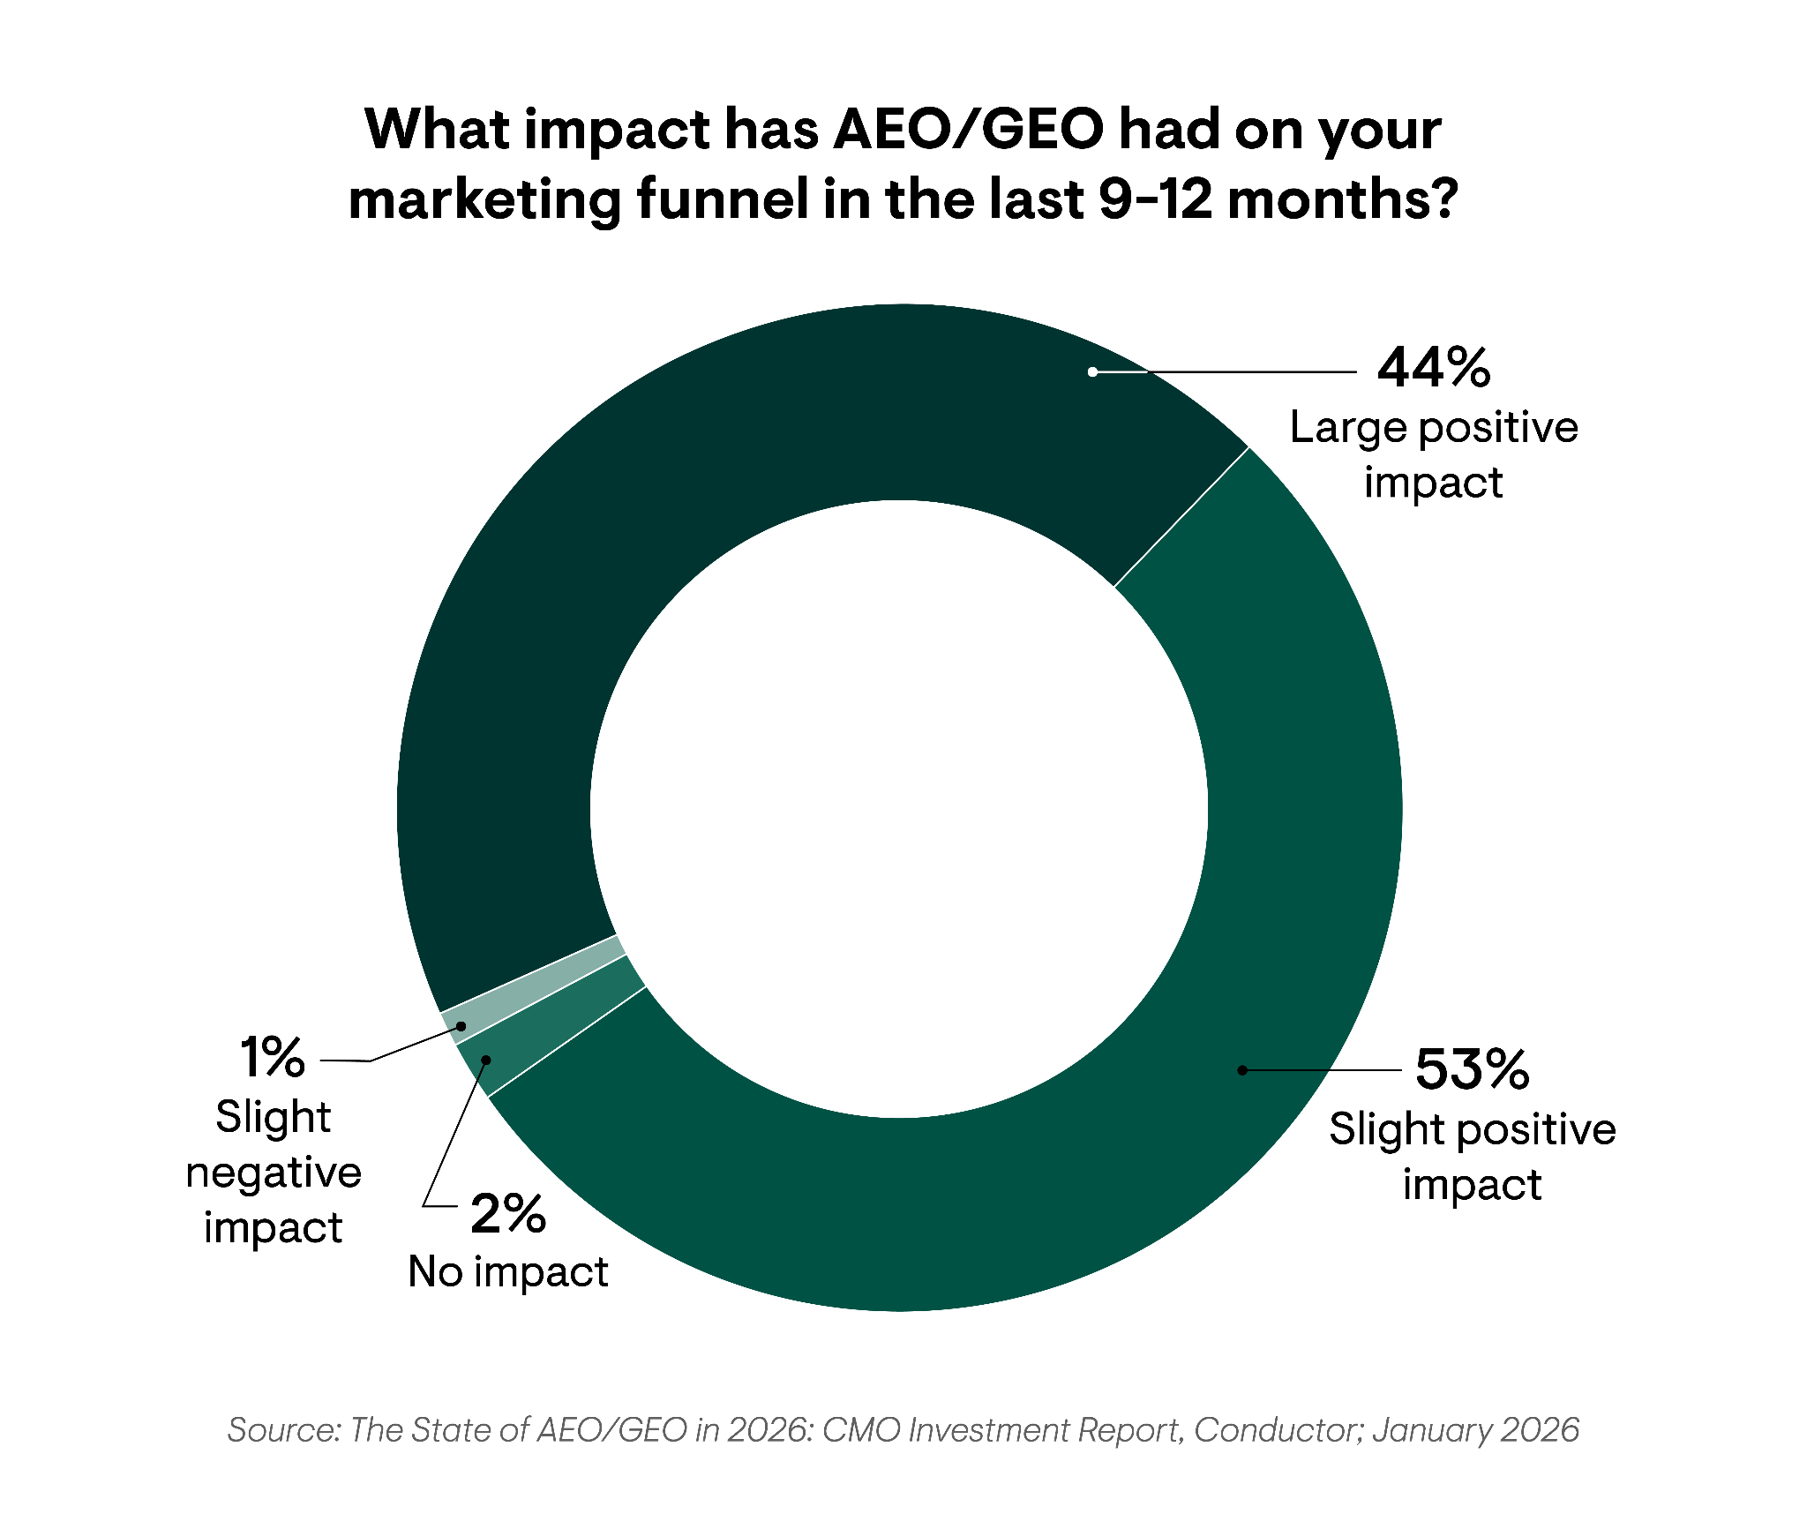
The Impact of AEO/GEO on the Marketing Funnel in 2025
AEO/GEO Strategy
Overall
97%
reported AEO had a positive impact on overall marketing funnel in 2025.
Despite the disruptions to the digital landscape and traditional SEO metrics like traffic, only 1% of respondents reported AEO/GEO negatively impacted their marketing funnel.
Volatility aside, executives and leaders are seeing the value of AEO/GEO within their strategies.

Slide 29
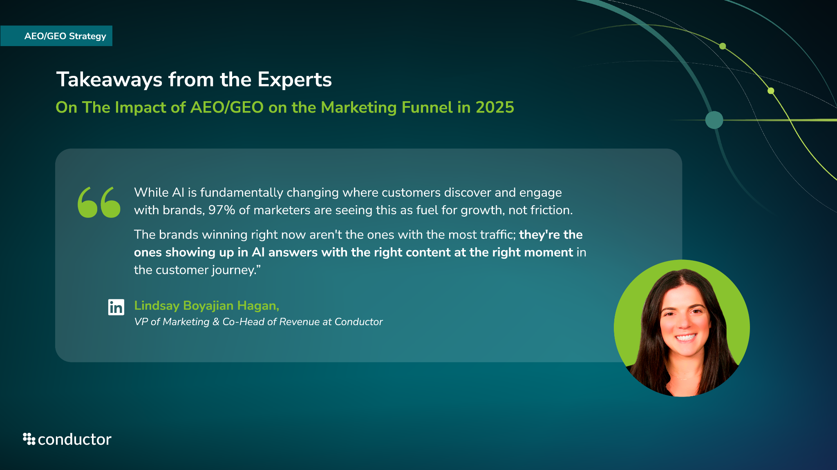

Slide 30
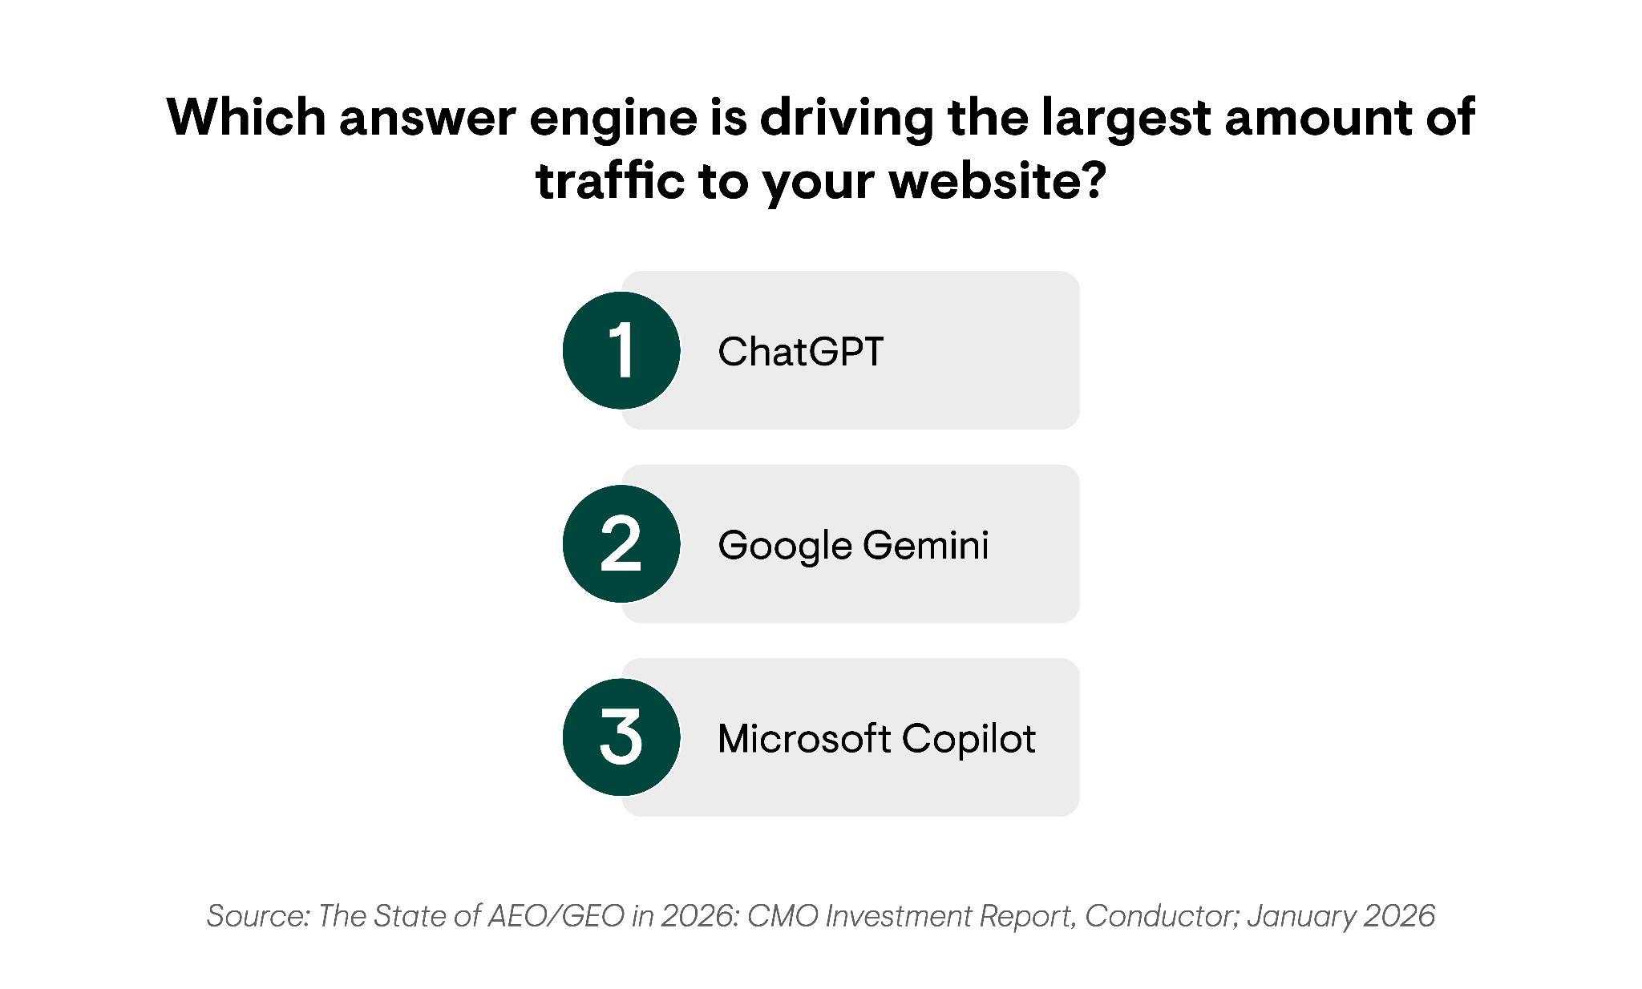
The Answer Engines Driving the Highest Share of Referral Traffic
AEO/GEO Strategy
Overall
ChatGPT contributed the largest amount of website traffic, followed by Gemini and Copilot.
These findings mirror our 2026 AEO/GEO Benchmarks Report, which found that 87% of all AI referral traffic across 10 analyzed industries came from ChatGPT.
This also tracks with higher overall user adoption of ChatGPT compared to other answer engines. In March 2025, ChatGPT reported over 500M weekly users, with Claude(3.3M), Copilot(2.4M), and Gemini(10.9M) reporting just a fraction of those weekly usage totals.

Slide 31
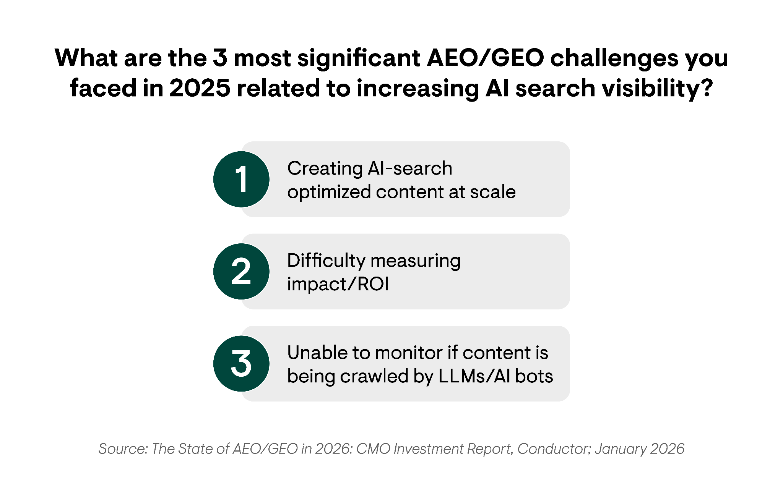
The Top AI Search Visibility Challenges of 2025
AEO/GEO Strategy
Overall
Being unable to monitor whether content is crawled by LLMs/AI bots ranked third among the top AEO/GEO challenges facing brands.
Yet, a majority of respondents reported using a dedicated monitoring tool. This highlights a potential disconnect in understanding the key features to look for in monitoring solutions for AEO/GEO efforts.
Some top AEO/GEO technology features that solve these challenges include:
24/7 website monitoring
LLM visibility across answer engines
Instant alerting when issues arise
Eliminate the guesswork and ensure your content is being crawled by AI bots.
Try for free

Slide 32
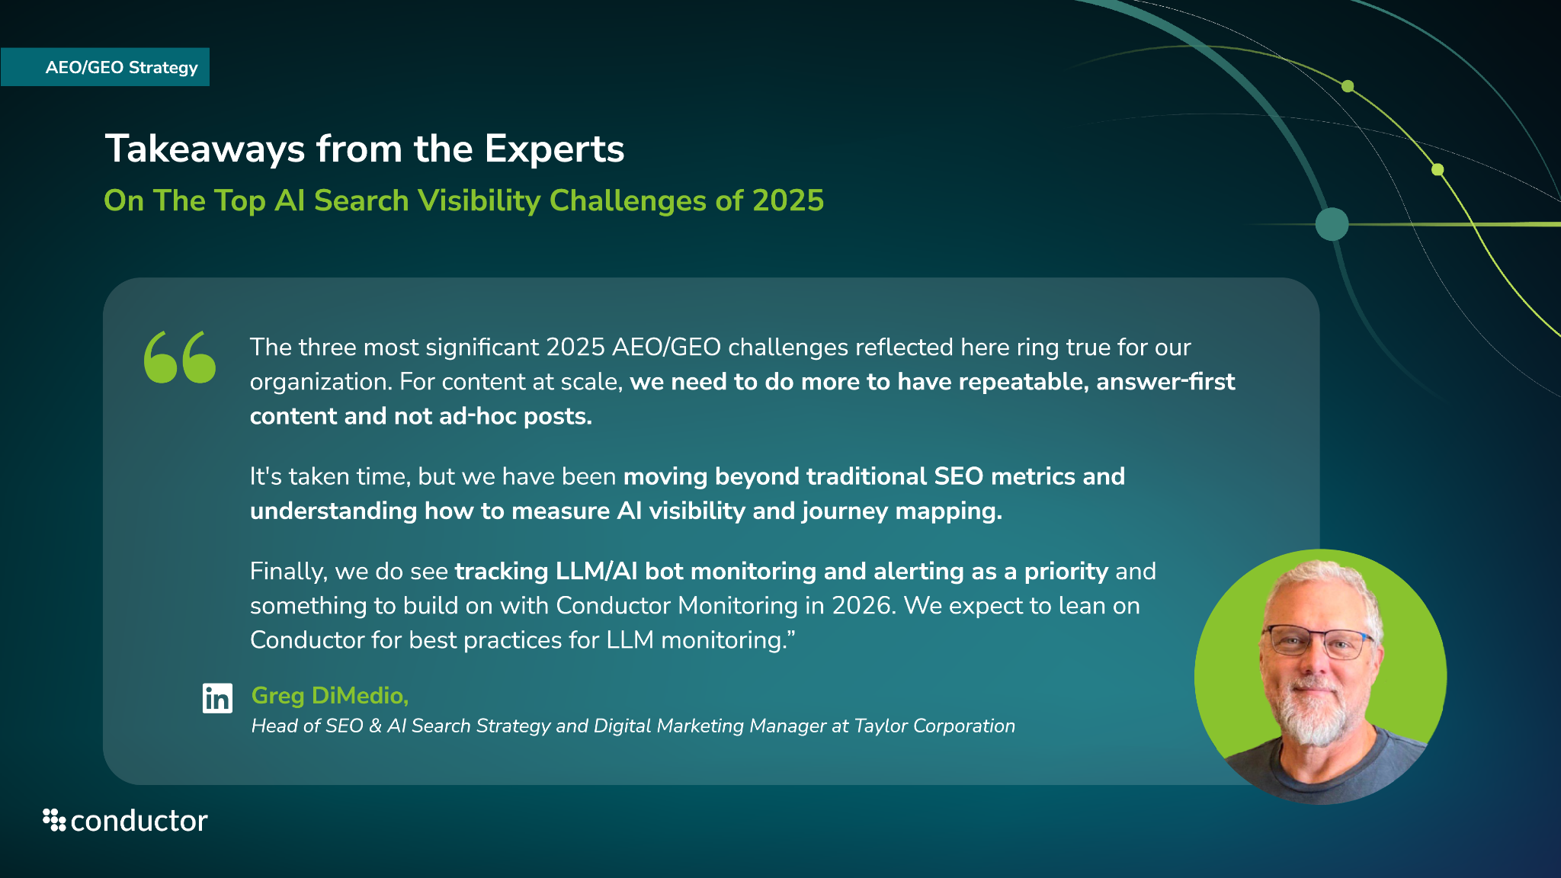

Slide 33
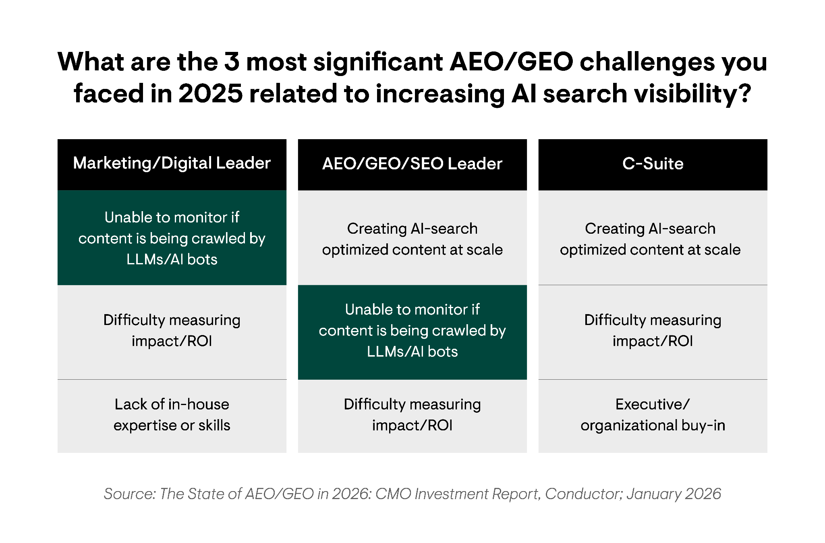
The Top AI Search Visibility Challenges of 2025
AEO/GEO Strategy
By Role Title
The biggest AEO/GEO challenge among C-suite leaders is the inability to create AI search-optimized content at scale.
For marketing/digital leaders, however, the biggest challenge is the lack of visibility into whether their content is being crawled by LLMs, which also ranked as the second biggest challenge for AEO/GEO/SEO leaders.
C-suite leaders are more focused on the big picture need of creating content at scale, but are more removed from the tactical need of ensuring that content is crawlable. By contrast, the AEO/GEO/SEO leaders recognize the value of both content generation and crawlability.
This highlights a potential disconnect in the way executives think about content discoverability. Creating more content at scale is a proven way to increase visibility, but that content is useless if LLMs can’t crawl and cite it within responses.

Slide 34
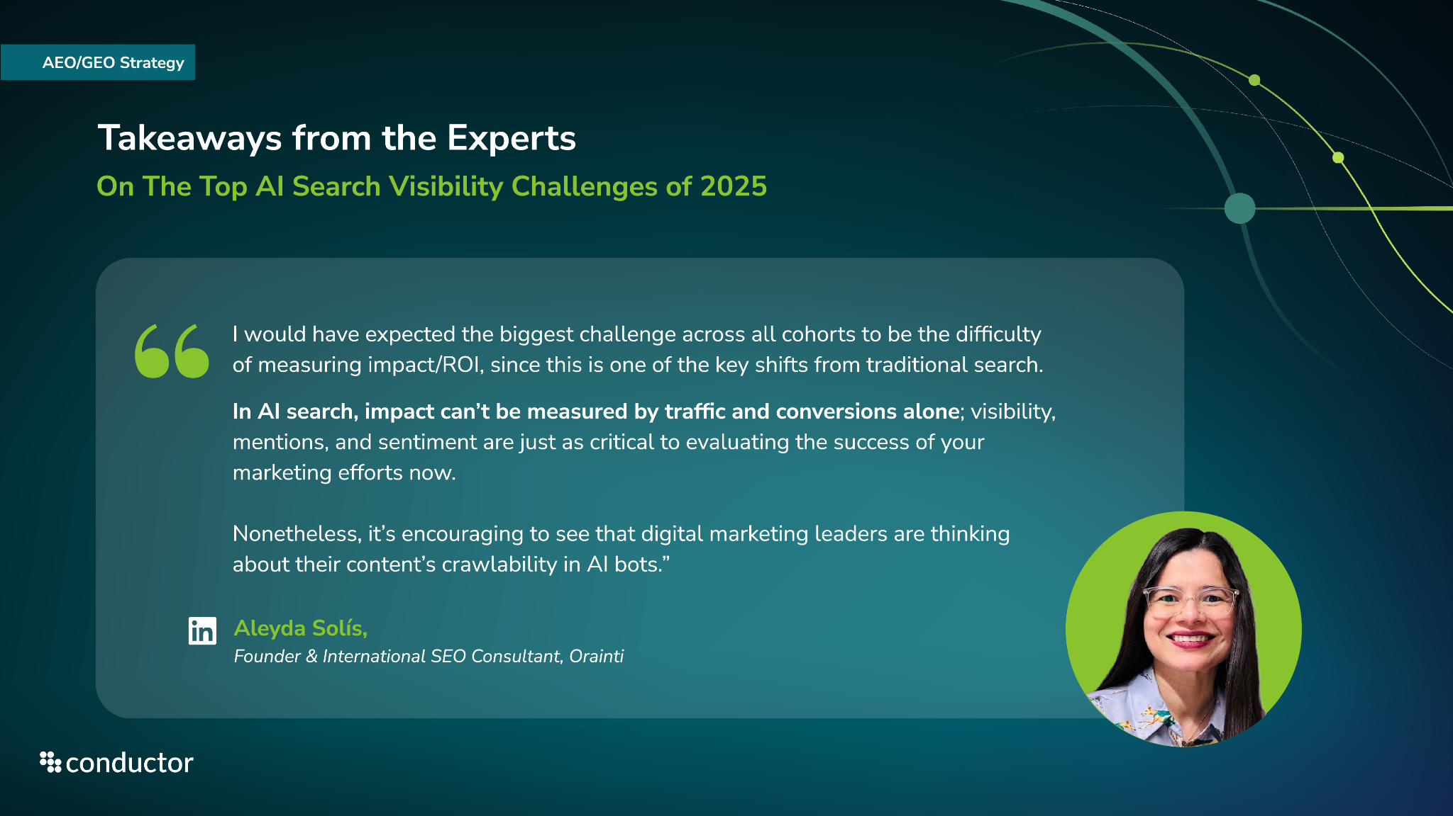

Slide 35
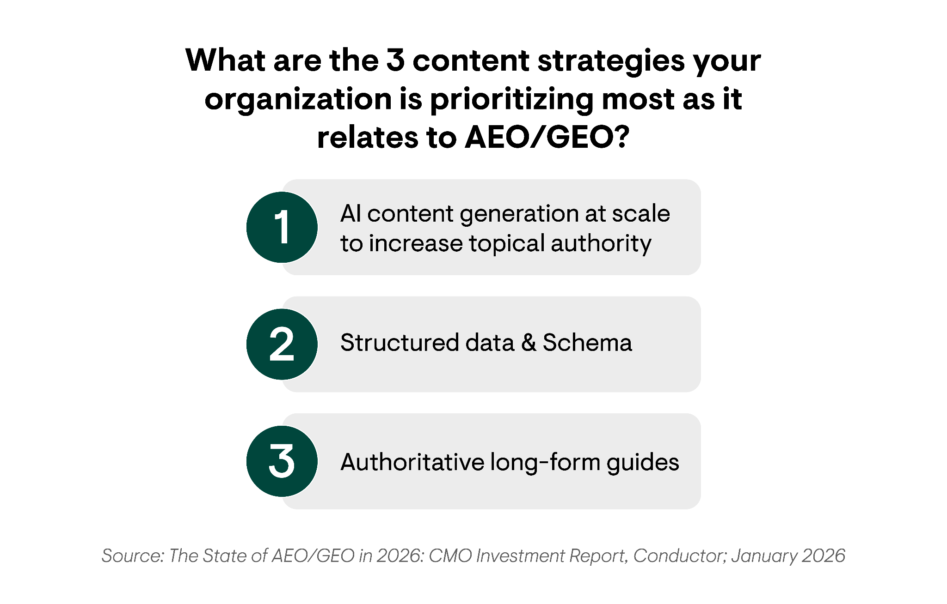
The Top AEO/GEO-Related Content Strategies
AEO/GEO Strategy
Overall
Scaling AI content generation to increase topical authority ranked as the #1 content priority related to AEO/GEO.
While Schema was seen as a nice-to-have in SEO, implementing and optimizing structured data and Schema ranked as the #2 content strategy that respondents are prioritizing because it allows LLMs and AI bots to more easily crawl and understand content.
Authoritative long-form guides, which rounded out the list, help establish brand expertise around key strategic topics. Organizations with large libraries of high-quality, in-depth content on key topics are more likely to be cited and mentioned by AI, because these domains are viewed as experts in the field and authoritative sources.

Slide 36
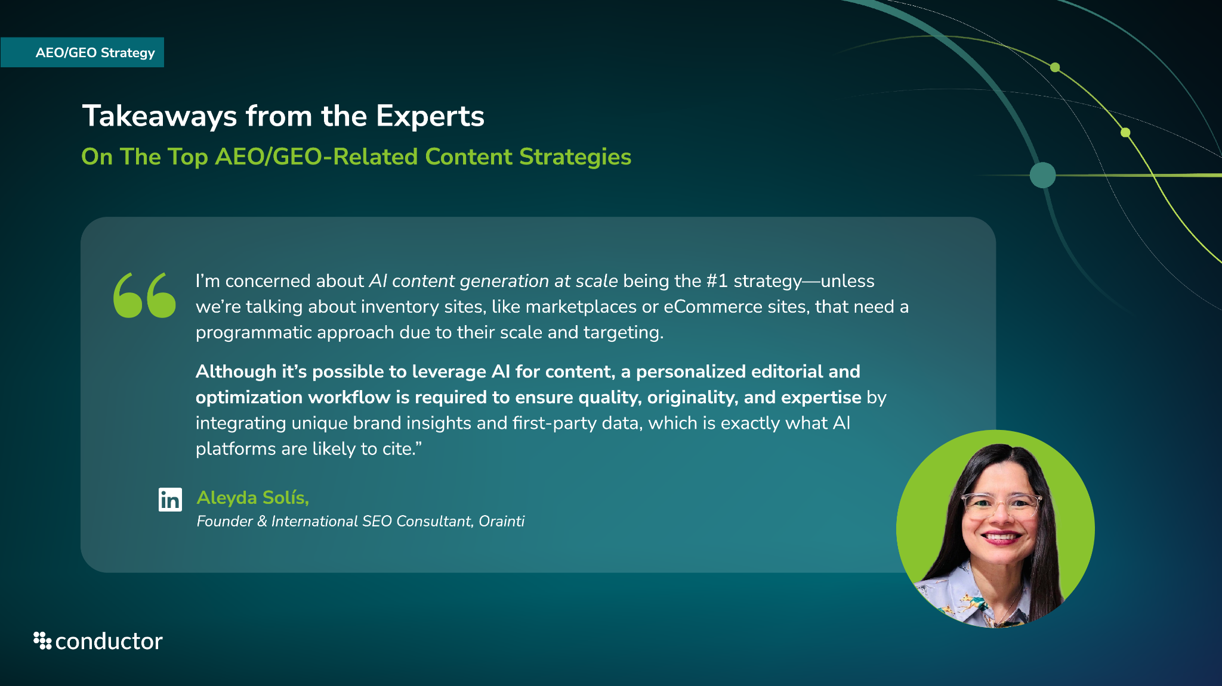

Slide 37
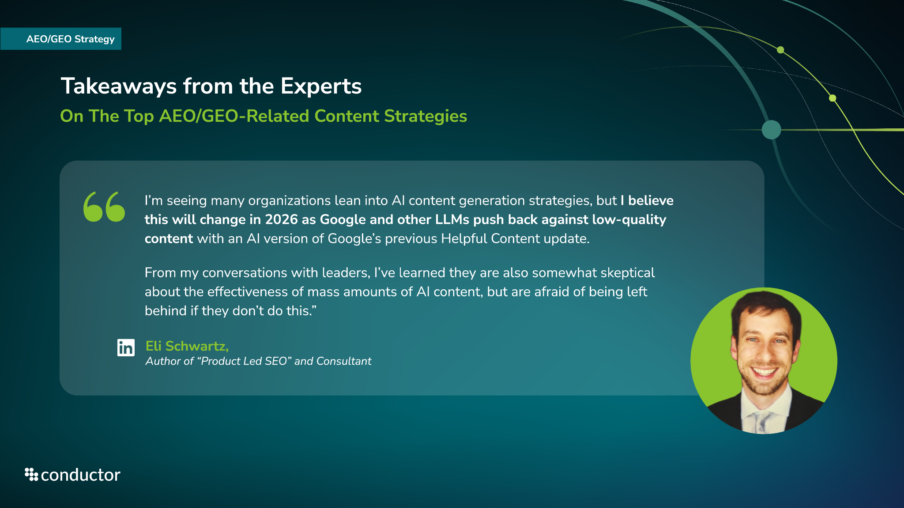

Slide 38
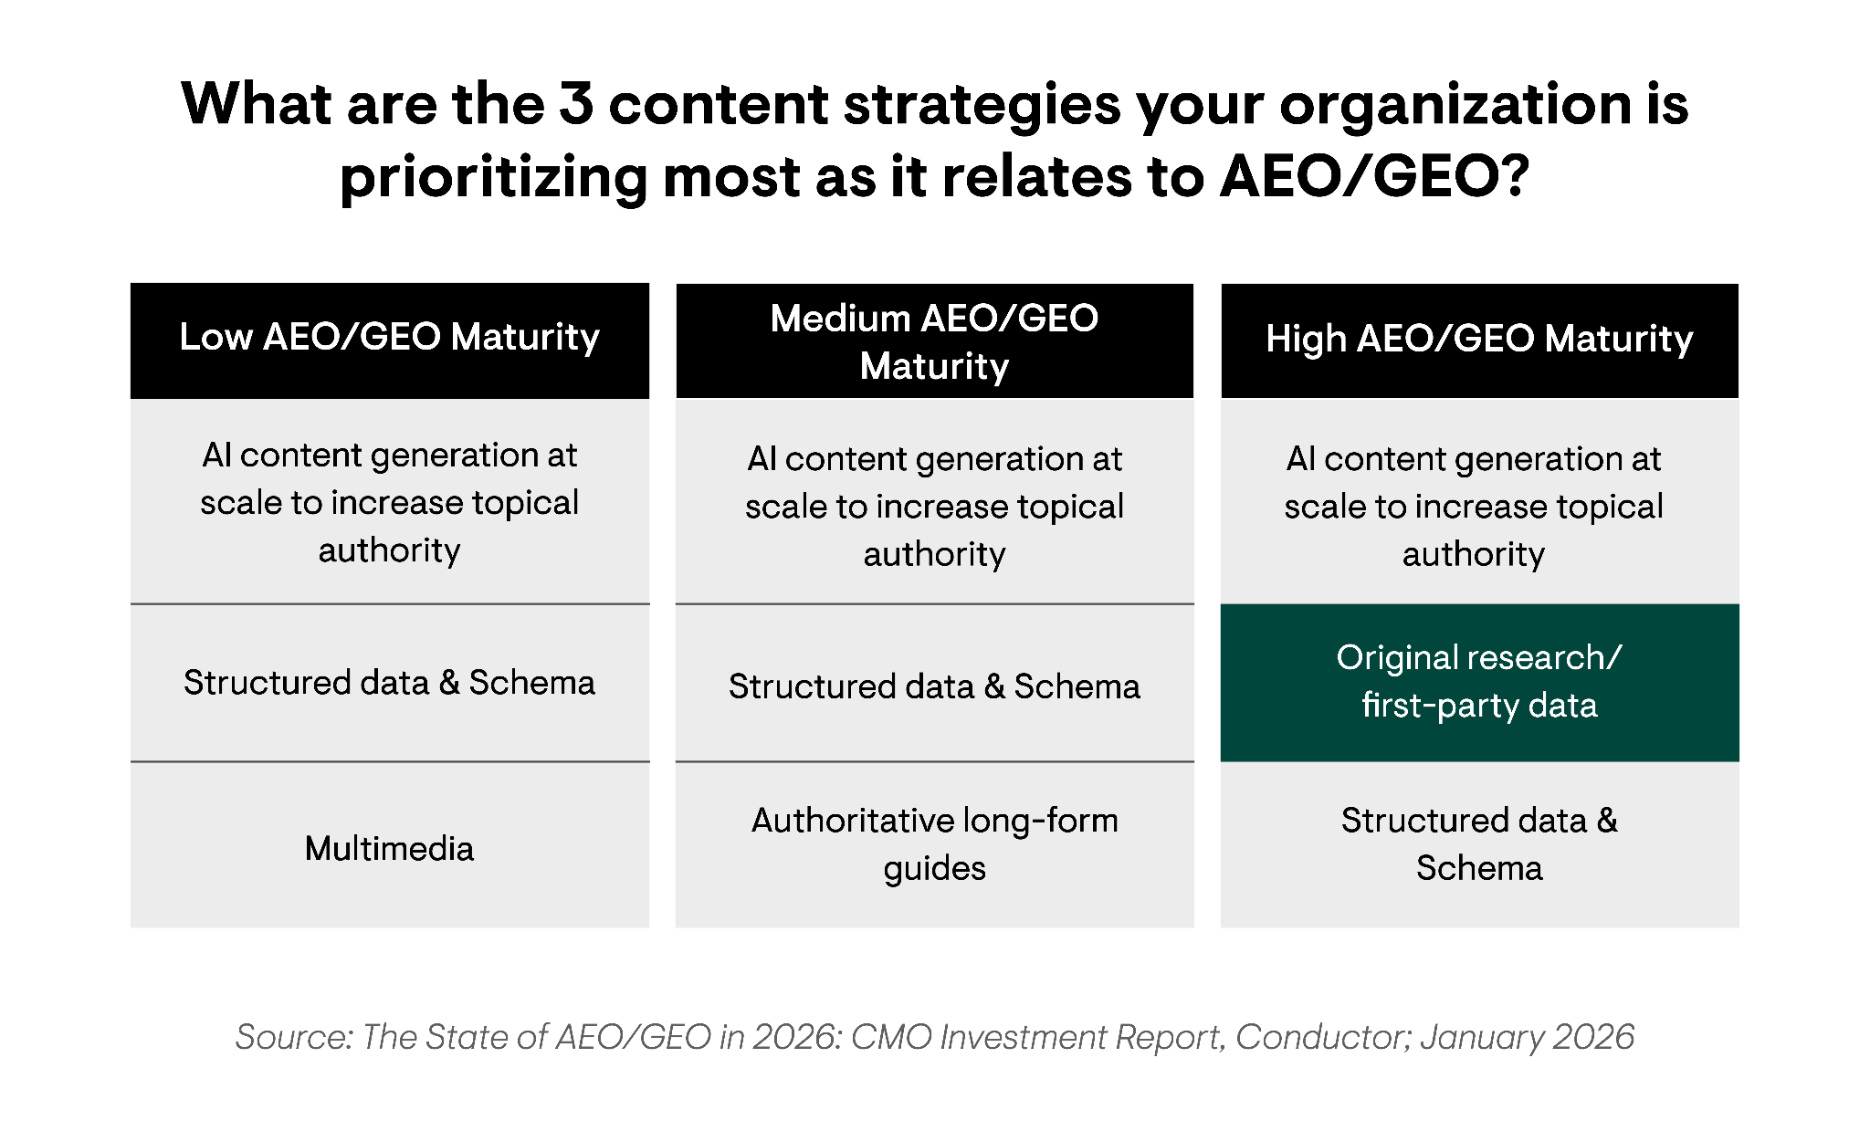
The Top AEO/GEO-Related Content Strategies
AEO/GEO Strategy
By AEO/GEO Maturity
Organizations with high AEO/GEO maturity were the only group to prioritize creating original research reports based on first-party data.
Why?
Publishing exclusive statistics or data points provides users with unique and valuable insights that they can’t get anywhere else.
This is another kind of authoritative, high-quality content that AI models and answer engines are more likely to cite directly in order to provide the most thorough and accurate answer possible.
Thanks to the exclusivity of the data, competitors will not be able to repurpose your findings without crediting you, unlike more generic informational content.

Slide 39
Future State: AEO/GEO in 2026

Slide 40
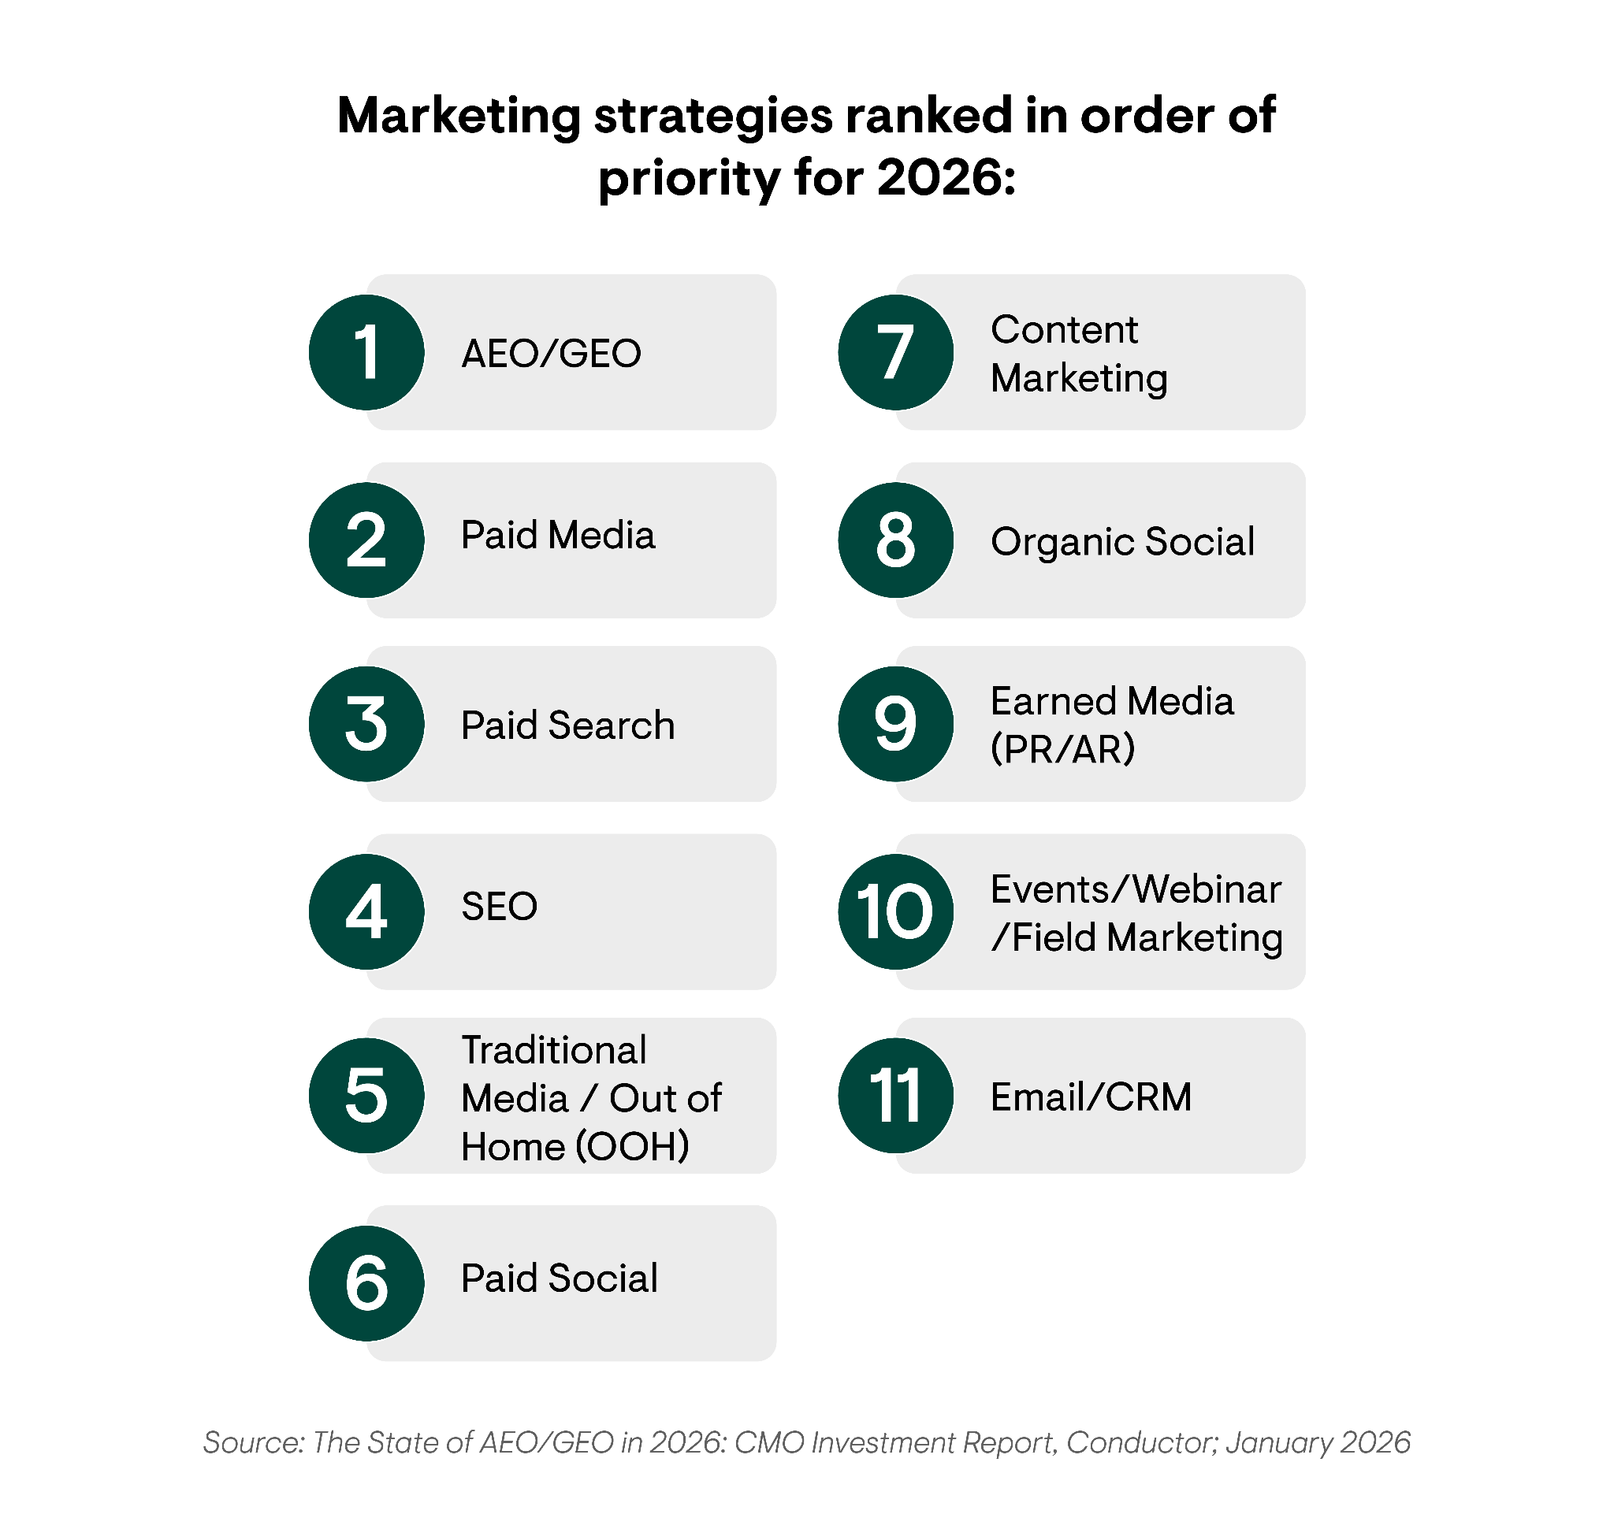
The Top Marketing Priorities for 2026
AEO/GEO in 2026
AEO/GEO Investments
Overall
32%
of respondents listed AEO/GEO as their top priority for 2026.
Paid spend still ranks high among top strategic priorities because it provides quick, short-term ROI that is easy to measure. But paying for the top spot on traditional SERPs isn’t as valuable in the age of AI search as it once was.
SEO still falls within the top 4 overall strategic priorities for enterprise organizations.
Why?
The goals of SEO and AEO/GEO are closely aligned.
Billions of searches still take place in Google every day, driving a significant amount of organic traffic.
Enterprise organizations realize they need to balance both efforts rather than choose between the two.

Slide 41
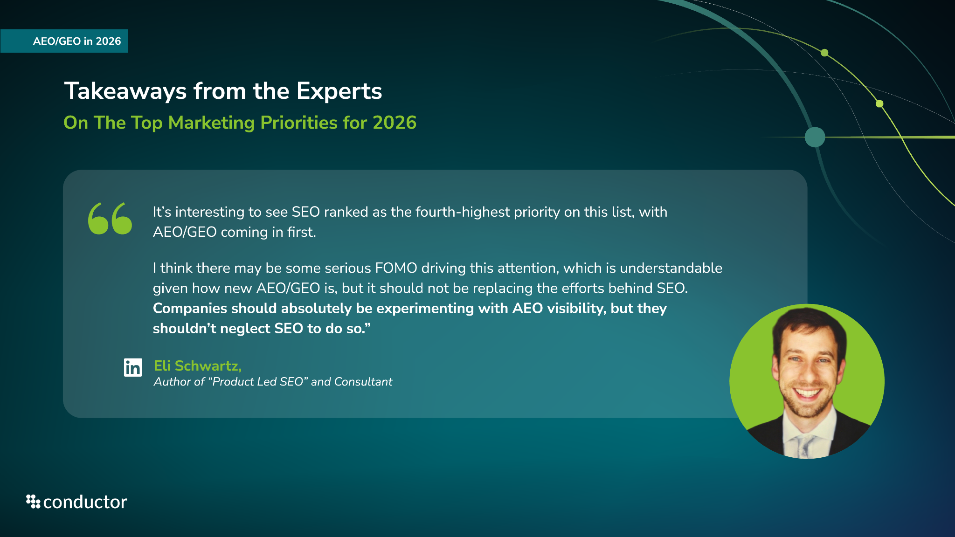

Slide 42
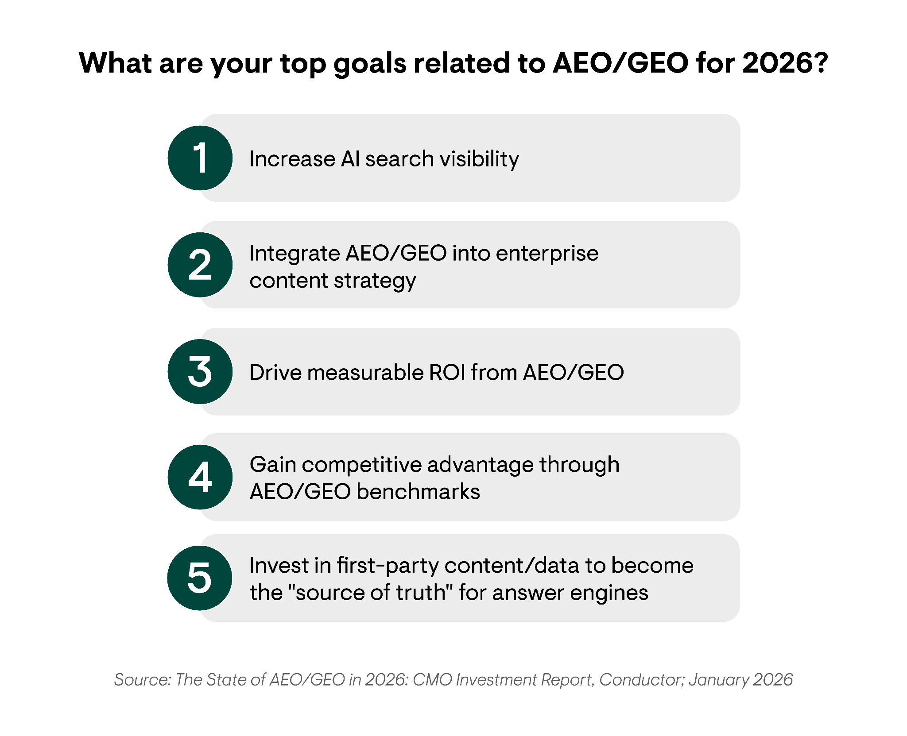

The Top AEO/GEO Goals for 2026
AEO/GEO in 2026
Overall
Increasing AI search visibility through brand mentions and domain citations ranked as the top AEO/GEO goal for digital leaders in 2026.
Helpful resource
Leveraging AEO/GEO benchmarks to gain a competitive advantage was another one of the top goals reported for 2026.
Our 2026 AEO/GEO Benchmarks Report provides the latest benchmarks for AI visibility, AI referral traffic, and AI search market share that organizations can use to measure AEO/GEO success against key competitors.

Slide 43
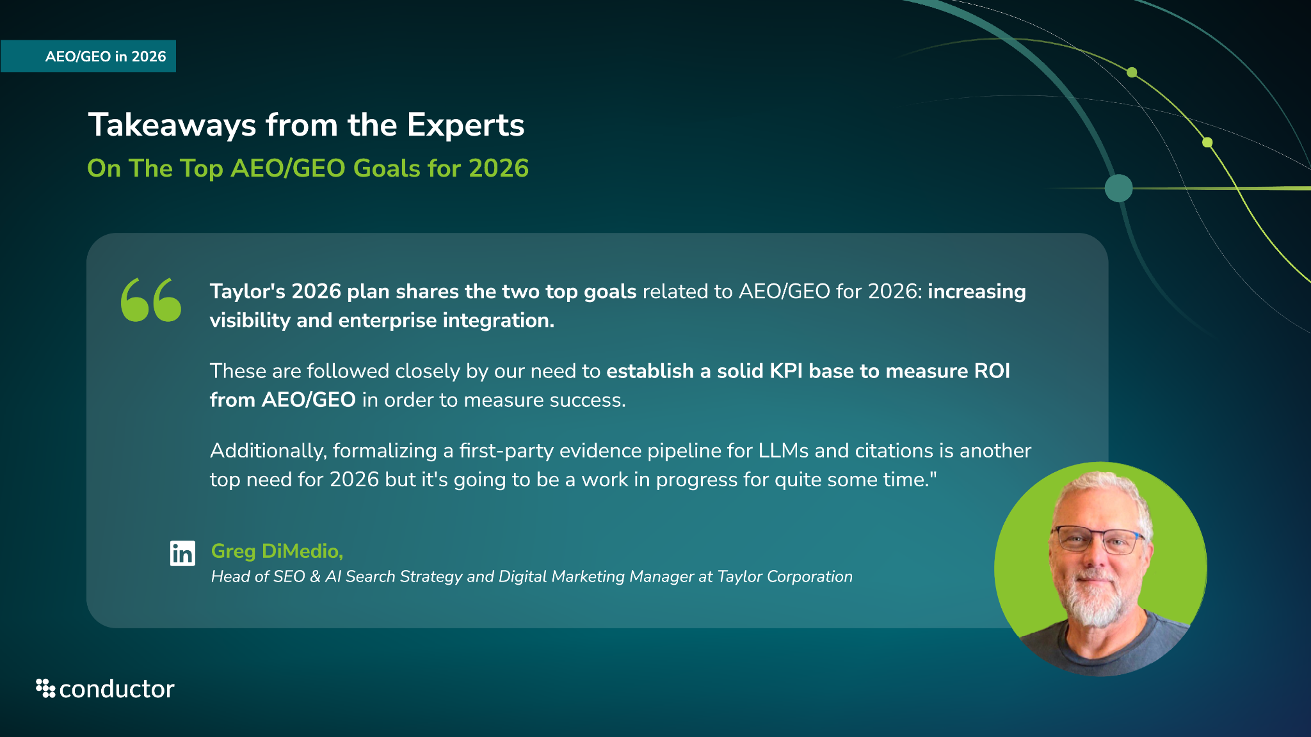

Slide 44
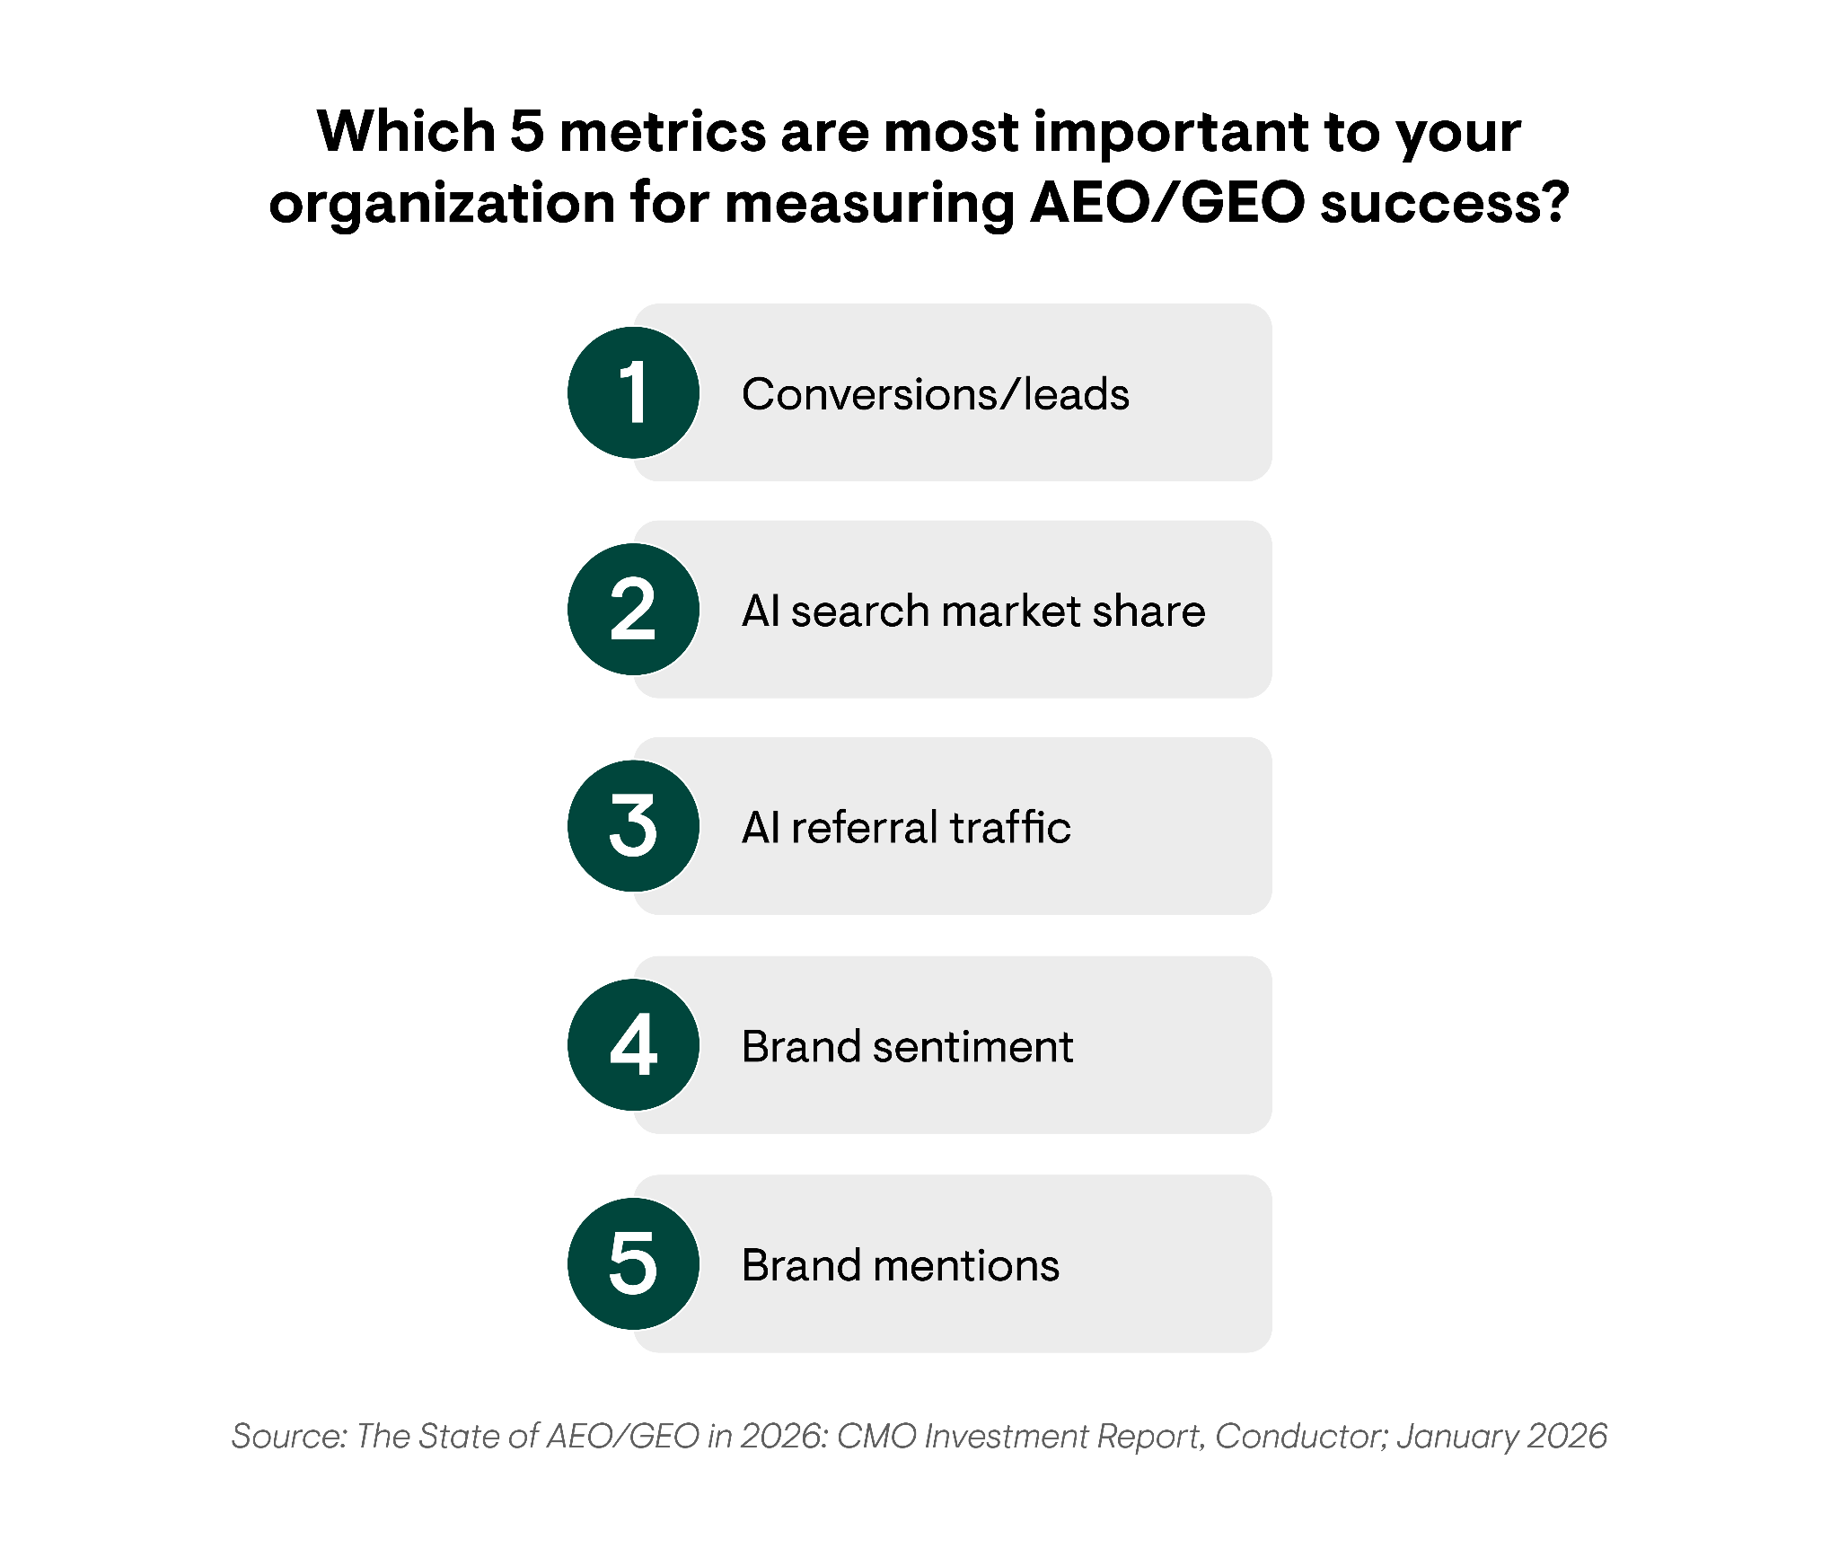
The Top AEO/GEO Metrics to Prioritize in 2026
AEO/GEO in 2026
SEO in 2024
AEO Technology
AEO Strategy
Overall
Conversions/leads from AI search is the top metric organizations are using to measure AEO/GEO
success in 2026.
While AI referral traffic still ranked in this list of metric priorities, the emphasis on conversions/leads and inclusion of brand mentions emphasize that leaders are starting to recognize the old metrics that determined SEO success (traffic, rankings) aren’t as valuable for AEO/GEO.
It’s a quality game vs. a numbers game. Forward-thinking leaders recognize that AI referral traffic rates will never match organic traffic. They are shifting focus from traffic quantity to the quality of conversions/leads driven by increased AI search visibility.

Slide 45
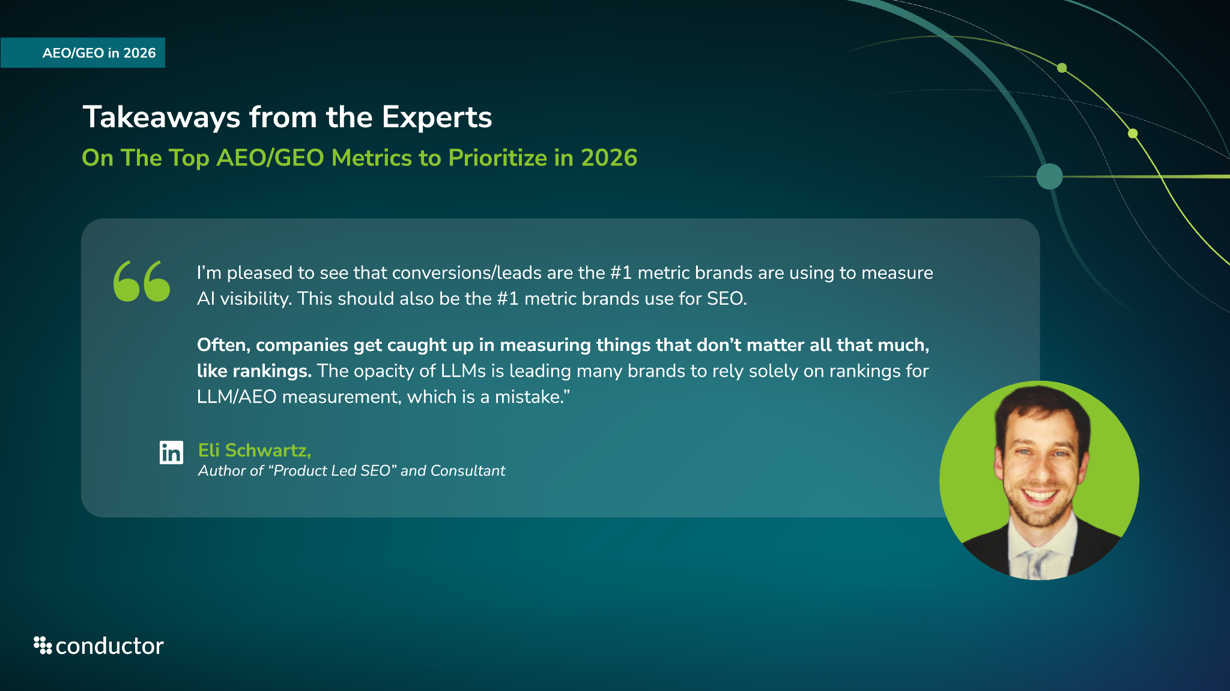

Slide 46
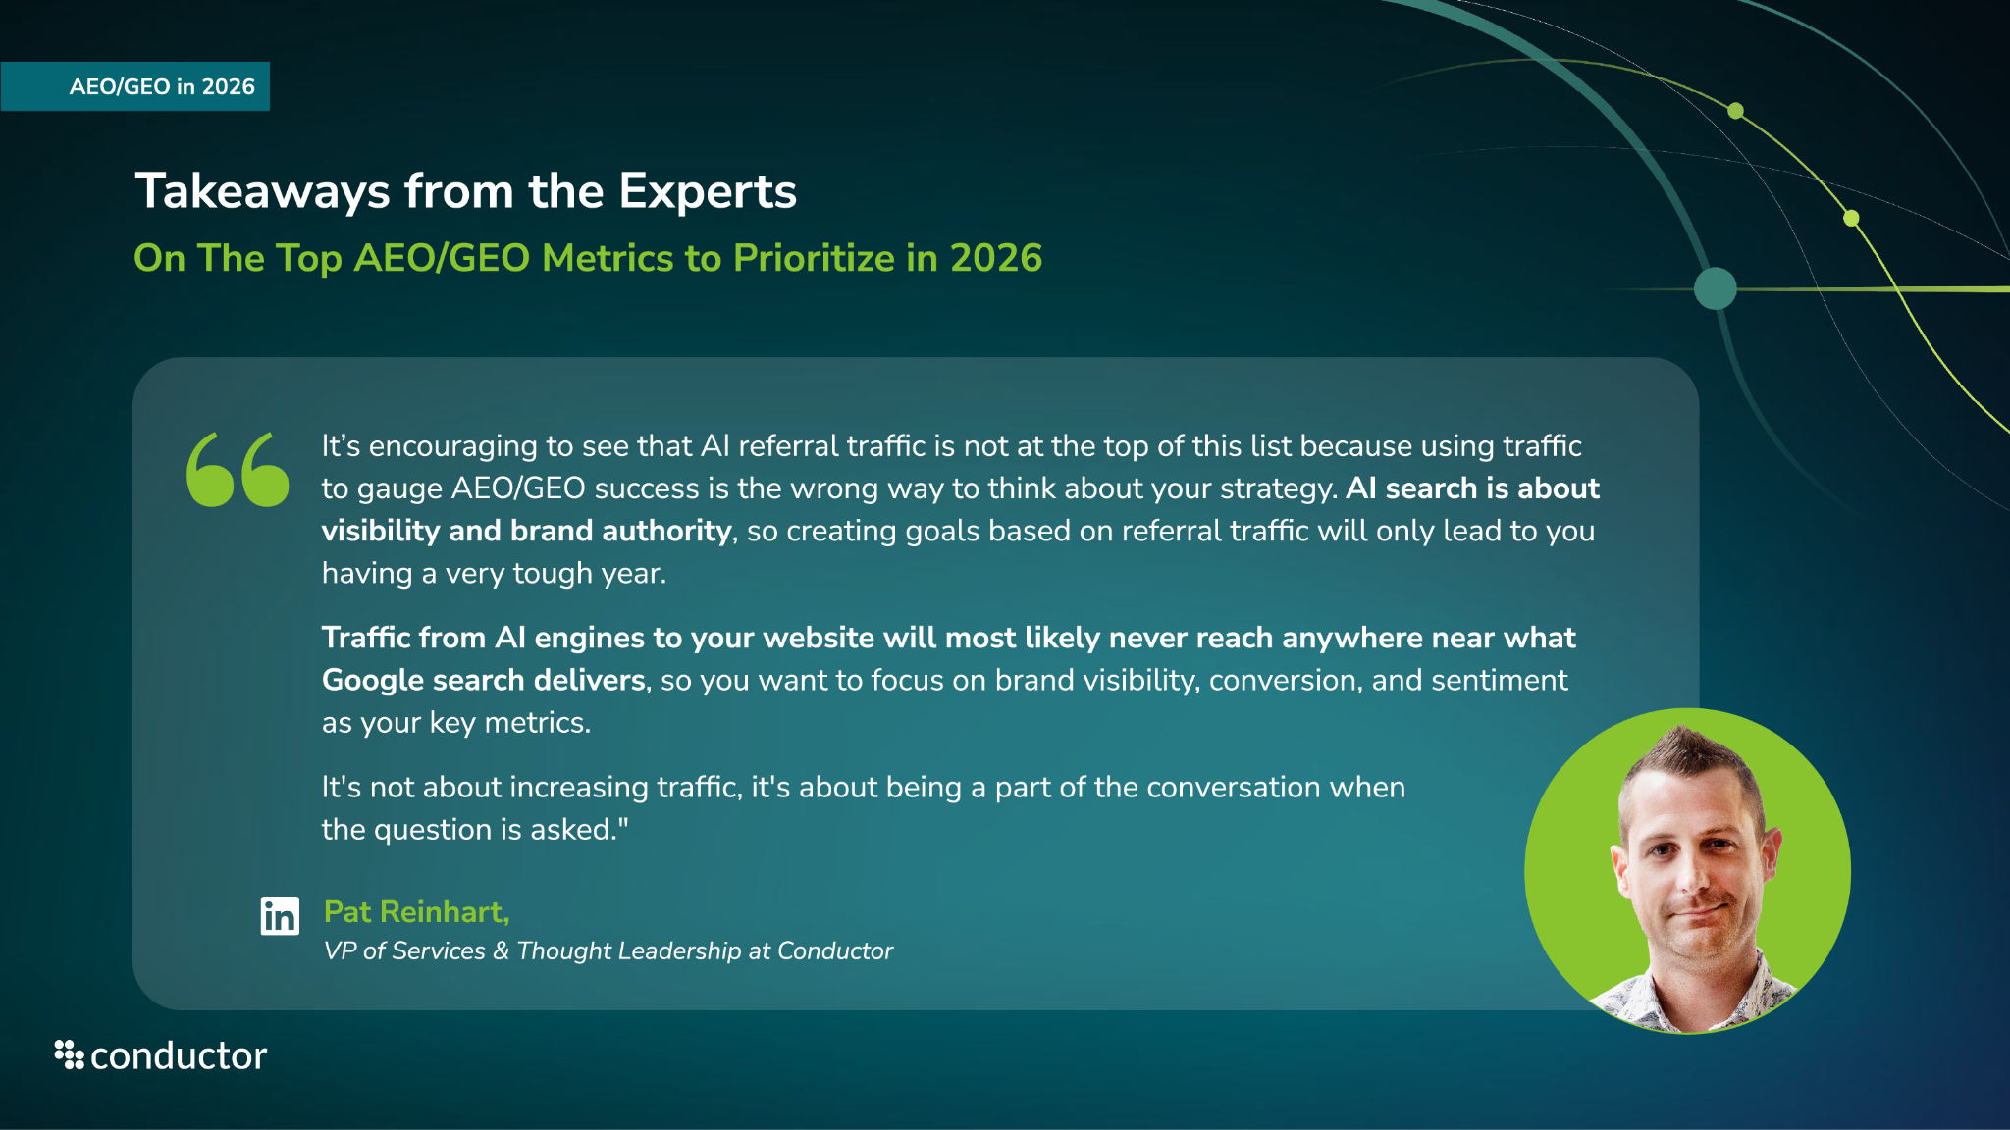

Slide 47
How AI Search Will Shape Marketing Strategy in 2026
AEO/GEO in 2026
We asked respondents how they expected AI search to shape their 2026 marketing strategy. Here are the common themes and key insights.
Content strategy is the main focus: The sentiment is that AI search and AEO require a fundamental shift in strategy to create content that directly answers conversational queries.
Personalization & audience understanding: Leaders plan to use AI to understand and predict what customers want, then deliver personalized content and answers at an individual level.
Data, insights, and measurable ROI: Leaders expect AI-driven solutions and technologies to provide clearer attribution and measurement and make marketing more accountable.
An increased focus on AEO/SEO: Leaders are planning to shift resources to optimize for conversational, intent-based queries rather than just keywords.
Key Insights from Respondents:
“It’s key to focus on AEO, hyper-personalization, optimizing for AI summaries, and boosting brand authority.”
"AI search will drive content strategy, visibility, and measurable marketing ROI."
"AI search and answer engines will transform marketing to be more personalized and targeted to assist us in delivering the right content to the right audience at the right time."
"AI search will guide monitoring, protect brand authority, and inform measurable marketing outcomes in 2026."

Slide 48
Top AEO/GEO Roles, Skills, & Technologies Enterprises Need for 2026
AEO/GEO in 2026
Here are the consistent themes we saw come up around the top AEO/GEO roles, skills, and technologies respondents are prioritizing for 2026 and beyond.
Hiring for specialized AI roles: Leaders are planning to hire for new, highly specialized roles, like AI strategists, AI content strategists, AEO/GEO data analysts, and AEO/SEO experts/specialists.
Improving technical SEO & content skills: Traditional SEO skills are insufficient. The future requires expertise in structured data, semantic search, and creating content for generative search and answer engines specifically.
Broad upskilling & adaptability: Leaders are planning for broad organizational training, focusing on AI literacy and flexibility.
AI Agents & MCPs: Leaders recognize the emerging role of MCP servers and the need to invest and deploy them so AI agents can interact with their data directly as more users leverage answer engines and agents.
Key Insights from Respondents:
"AI content specialists, data analysts, SEO strategists, and monitoring technologies are needed."
"Enterprises will need to develop new roles like AEO and GEO specialists, acquire skills in conversational writing, structured data markup, and entity recognition.”
"Enterprises will need AI strategists, prompt enginess, and structured-data experts to optimize for AEO/GEO."
"Skilled leaders who can manage workforce adaptation and guide enterprise-wide adoption of new technologies."
"We will need to make sure all levels of the organization are up to speed on AEO/GEO initiatives."

Slide 49

Summary
The transition to AI-powered search is ramping up, fundamentally redefining digital discoverability.
The future remains bright with 97% of digital leaders reporting a positive impact from AEO/GEO in 2025, driving 94% to increase their related investments in 2026.
For enterprise organizations, AEO/GEO success hinges on investing in internal AEO/GEO expertise, expanding brand authority, and investing in a fully integrated AEO platform to unify visibility data and scale content optimization. This holistic approach is what will separate successful organizations from the competition and ensure sustained relevance in the age of AI.
Try Conductor for free
Start your free trial of Conductor—the #1 enterprise AEO/GEO platform—for a complete picture of your digital visibility and actionable optimization intelligence.

