Slide 1



C-Suite Level SEO Reporting
April 13, 2023 — Steven van Vessum

Slide 2
Conductor C-Suite reporting template guidelines
Make your slide titles the key takeaway you want execs to know. They will pay attention to these so communicate top insights here.
Your report should focus on being: concise, credible (and consistent), compelling, comparable AKA compare to competitors benchmarks.
Every slide should make clear what the takeaway or story is.
When you include a chart or table, always include the key takeaways.
If you underperformed, don’t just bring the bad news. Explain your action plan on how to mitigate it.
Source: https://www.conductor.com/academy/seo-reporting/
Explainer slide, not meant
to be included in the final presentation.

Slide 3


Agenda
Executive summary
SEO Performance detail
Takeaways
Questions
Presentation duration
60 minutes
Notes:
This slide is made up from a master slide.

Slide 4
The buyer journey consists of many touch points.
All channels contribute to the purchase, and should all be valued.
Notes:
GUIDANCE: Set the stage and make it clear to the C-suite that the buyer journey is messy, and consists of many touch points.
Resources:
https://sparktoro.com/blog/presentations/dont-know-audience/
Example of different attribution models: https://support.google.com/analytics/answer/1662518?hl=en.
Check out the guide to SEO reporting here: https://www.conductor.com/academy/seo-reporting/

Slide 5
B2B Executive summary
Notes:
There are two Executive summaries: a B2B one and a B2C one. This is the B2B one.
Check out the guide to SEO reporting here: https://www.conductor.com/academy/seo-reporting/

Slide 6




B2B Executive summary
Our SEO goals for QX 202X
Revenue
$5,000,000
SQLs
750
MQLs
2,500
Visitors
250,000
Notes:
GUIDANCE: Start by outlining the goals for the quarter that you’re going to be reporting on so the audience gets a refresher.
Check out the guide to SEO reporting here: https://www.conductor.com/academy/seo-reporting/

Slide 7
B2B Executive summary
We overshot our revenue goal by 13%
Revenue
$5,000,000
SQLs
750
MQLs
2,500
Visitors
250,000
Actuals
$5,650,000 (+13%)
+25% YoY
Actuals
800 (+7%)
+23% YoY
Actuals
2,650 (+6%)
+26% YoY
Actuals
280,000 (+12%)
+40% YoY
Notes:
GUIDANCE: Present the actuals and overall sentiment (Good/OK/Bad). On the next slide you’ll explain in brief why you performed the way you did.
Check out the guide to SEO reporting here: https://www.conductor.com/academy/seo-reporting/

Slide 8
Revenue: $5,65M on a $5M goal
B2B Executive summary
Key Takeaways
1
Text
This quarter’s performance compared:
QoQ performance: +10%
YoY performance: +20%
2
Text
Notes:
GUIDANCE
Include the performance against last quarter’s performance, as well as the YoY performance (this will take out seasonality effects).
Be sure to be able to explain the trends you’re seeing.
Explain that the detailed SEO performance slide go into more detail.
Check out the guide to SEO reporting here: https://www.conductor.com/academy/seo-reporting/

Slide 9

B2B Executive summary
Our performance explained
Strengths
Growth opportunities
Website migration went better than expected.
MQL to SQL conversion was higher than expected.
Total revenue exceeded expectations.
Generating enough topics to cover for next quarter.
Visitor to MQL conversion was slightly lower than expected.
Notes:
GUIDANCE: Explain the main drivers behind the performance.
Check out the guide to SEO reporting here: https://www.conductor.com/academy/seo-reporting/

Slide 10
Our performance relative to the competition
B2B Executive summary
Company | Market share (Non-branded)
Us | 12% (+3%)
Competitor X | 16% (-1%)
Competitor Y | 11% (+2%)
Competitor Z | 9% (no change)
Notes:
GUIDANCE: Explain your performance relative to the competition. You can’t report on the same metrics that you report on for yourself, so you’ll have to go with what you do have: market share, in SEO commonly referred to as “share of voice”. It’s a metric calculated across all of your tracked keywords. The reason we don’t recommend including estimated organic traffic here is because competitors may offer more services than you do, and it’s likely they have higher estimated organic traffic because of that.
Check out the guide to SEO reporting here: https://www.conductor.com/academy/seo-reporting/

Slide 11
Our performance relative to the competition
B2B Executive summary
Company | Market share <category>
Us | 20% (+6%)
Competitor X | 11% (-3%)
Competitor Y | 9% (-2%)
Competitor Z | 7% (no change)
Notes:
GUIDANCE: Explain your performance relative to the competition. You can’t report on the same metrics that you report on for yourself, so you’ll have to go with what you do have: market share, in SEO commonly referred to as “share of voice”. It’s a metric calculated across all of your tracked keywords. The reason we don’t recommend including estimated organic traffic here is because competitors may offer more services than you do, and it’s likely they have higher estimated organic traffic because of that.
Check out the guide to SEO reporting here: https://www.conductor.com/academy/seo-reporting/

Slide 12
B2C Executive summary
Notes:
There are two Executive summaries: a B2B one and a B2C one. This is the B2C one.
Check out the guide to SEO reporting here: https://www.conductor.com/academy/seo-reporting/

Slide 13
B2C Executive summary
Our SEO goals for QX 202X
Revenue
$2,500,000
Conversions
3,200
Visitors
210,000
Market share
9%
Notes:
GUIDANCE: Start by outlining the goals for the quarter that you’re going to be reporting on so the audience gets a refresher.
Check out the guide to SEO reporting here: https://www.conductor.com/academy/seo-reporting/

Slide 14
B2C Executive summary
We overshot our revenue goal by 12%
Revenue
$2,500,000
Conversions
3,200
Visitors
210,000
Market share
9%
Actuals
$2,800,000 (+12%)
+25% YoY
Actuals
3,450 (+8%)
+23% YoY
Actuals
225,000 (+7%)
+26% YoY
Actuals
11% (+22%)
+4% YoY
Notes:
GUIDANCE: Present the actuals and overall sentiment (Good/OK/Bad). On the next slide you’ll explain in brief why you performed the way you did.
Check out the guide to SEO reporting here: https://www.conductor.com/academy/seo-reporting/

Slide 15
Revenue: $2,8M on a $2,5M goal
B2C Executive summary
Key Takeaways
1
Text
This quarter’s performance compared:
QoQ performance: +7%
YoY performance: +25%
2
Text
Notes:
GUIDANCE
Include the performance against last quarter’s performance, as well as the YoY performance (this will take out seasonality effects).
Be sure to be able to explain the trends you’re seeing.
Explain that the detailed SEO performance slide go into more detail.
Check out the guide to SEO reporting here: https://www.conductor.com/academy/seo-reporting/

Slide 16
B2C Executive summary
Our performance explained
Strengths
Growth opportunities
Website migration went better than expected.
Visitor to Conversion conversion rate
was higher than expected.
Total revenue exceeded expectations.
Generating enough topics to cover for next quarter.
Amount of visitors was slightly lower than expected.
Notes:
GUIDANCE: Explain the main drivers behind the performance.
Check out the guide to SEO reporting here: https://www.conductor.com/academy/seo-reporting/

Slide 17
Our performance relative to the competition
B2C Executive summary
Company | Market share (Non-branded)
Us | 12% (+3%)
Competitor X | 16% (-1%)
Competitor Y | 11% (+2%)
Competitor Z | 9% (no change)
Notes:
GUIDANCE: Explain your performance relative to the competition. You can’t report on the same metrics that you report on for yourself, so you’ll have to go with what you do have: market share, in SEO commonly referred to as “share of voice”. It’s a metric calculated across all of your tracked keywords. The reason we don’t recommend including estimated organic traffic here is because competitors may offer more services than you do, and it’s likely they have higher estimated organic traffic because of that.
Check out the guide to SEO reporting here: https://www.conductor.com/academy/seo-reporting/

Slide 18
Our performance relative to the competition
B2C Executive summary
Company | Market share <category>
Us | 20% (+6%)
Competitor X | 11% (-3%)
Competitor Y | 9% (-2%)
Competitor Z | 7% (no change)
Notes:
GUIDANCE: Explain your performance relative to the competition. You can’t report on the same metrics that you report on for yourself, so you’ll have to go with what you do have: market share, in SEO commonly referred to as “share of voice”. It’s a metric calculated across all of your tracked keywords. The reason we don’t recommend including estimated organic traffic here is because competitors may offer more services than you do, and it’s likely they have higher estimated organic traffic because of that.
Check out the guide to SEO reporting here: https://www.conductor.com/academy/seo-reporting/

Slide 19
SEO performance in detail

Slide 20
SEO performance in detail
Metrics to report on
Revenue
SQLs
MQLs
Leads
Explainer slide, not meant
to be included in the final presentation.
Visitors + Visibility Zones
Notes:
GUIDANCE
This slide is meant to explain what you’d report on ideally. This should not be included in the actual slide deck that you’re presenting.
It’s important to explain that SEO influences Leads, MQLs, SQLs and Revenue just like any other traffic source. No one traffic source is solely responsible for conversions. The whole customer journey should be considered. And you need to keep in mind attribution models too.
Focus on the top metrics in the pyramid when reporting to the C-Suite because they’re talking about the same metrics day in, day out.
Being able to report on all of these metrics is the ideal scenario. Not all organizations will be able to, so then you report on the metrics you can track from top to bottom. The more you’re reporting on metrics at the bottom of the pyramid, the harder it’ll be for you to show the value of SEO.
Check out the guide to SEO reporting here: https://www.conductor.com/academy/seo-reporting/

Slide 21
Revenue: $5,65M on a $5M goal
SEO performance in detail
Key Takeaways
1
Text
Five top performing assets that drove $4.5M of the revenue:
 | Topic | Revenue
1. | How to write a Content Brief | $1.4M
2. | How to Perform a Content Audit | $1.1M
3. | How to Prepare for a Google Algo Update | $0.9M
4. | How to leverage AI-Generated Content | $0.7M
5. | How to Performing a Competitive Analysis | $0.4M
2
Text
Notes:
GUIDANCE
Once more highlight the total revenue that SEO influenced, and describe the top performing articles and/or site sections.
Explain how you’ll feed these learnings back into your SEO strategy. For example, you’re seeing that certain content topics do great with your audience so you need to create more content around those topics.
Check out the guide to SEO reporting here: https://www.conductor.com/academy/seo-reporting/

Slide 22
Revenue: $5,65M on a $5M goal
SEO performance in detail
Key Takeaways
1
Text
This quarter’s performance compared:
QoQ performance: +10%
YoY performance: +20%
2
Text
Notes:
GUIDANCE
Include the performance against last quarter’s performance, as well as the YoY performance (this will take out seasonality effects).
Be sure to be able to explain the trends you’re seeing.
Check out the guide to SEO reporting here: https://www.conductor.com/academy/seo-reporting/

Slide 23
SQLs: 800 on a 750 goal
SEO performance in detail
Key Takeaways
1
Text
Five top performing assets that influenced 500 SQLs:
 | Topic | SQLs | Revenue
1. | How to write a Content Brief | 150 | $1.4M
2. | How to Perform a Content Audit | 125 | $1.1M
3. | How to Prepare for a Google Algo Update | 100 | $0.9M
4. | How to leverage AI-Generated Content | 75 | $0.7M
5. | How to Performing a Competitive Analysis | 50 | $0.4M
Text
2
3
Text
Notes:
GUIDANCE
Once more highlight the total SQLs that SEO influenced and describe the top performing articles and/or site sections.
Explain how you’ll feed these learnings back into your SEO strategy. For example, you’re seeing that certain content topics do great with your audience so you need to create more content around those topics.
Explain how content topics/themes are influencing a SQL’s value — some SQLs are generating more revenue than others.
Check out the guide to SEO reporting here: https://www.conductor.com/academy/seo-reporting/

Slide 24
SQLs: 800 on a 750 goal
SEO performance in detail
Key Takeaways
1
Text
This quarter’s performance compared:
QoQ performance: +10%
YoY performance: +20%
2
Text
3
Text
Notes:
GUIDANCE
Include the performance against last quarter’s performance, as well as the YoY performance (this will take out seasonality effects).
Be sure to be able to explain the trends you’re seeing.
Check out the guide to SEO reporting here: https://www.conductor.com/academy/seo-reporting/

Slide 25
MQLs: 2,650 on a 2,500 goal
SEO performance in detail
Key Takeaways
1
Text
Top performing content assets that drove 1,700 MQLs:
 | Topic | MQLs | SQLs | Revenue
1. | How to write a Content Brief | 500 | 150 | $1.4M
2. | How to Perform a Content Audit | 450 | 125 | $1.1M
3. | How to Prepare for a Google Algo Update | 350 | 100 | $0.9M
4. | How to leverage AI-Generated Content | 250 | 75 | $0.7M
5. | How to Performing a Competitive Analysis | 150 | 50 | $0.4M
2
Text
3
Text
Notes:
GUIDANCE
Once more highlight the total MQLs that SEO influenced, and describe the top performing articles and/or site sections.
Explain how you’ll feed these learnings back into your SEO strategy. For example, you’re seeing that certain content topics do great with your audience so you need to create more content around those topics.
Explain how content topics/themes are influencing a MQL’s value — some MQLs are convert to SQLs at a higher rate.
Check out the guide to SEO reporting here: https://www.conductor.com/academy/seo-reporting/

Slide 26
MQLs: 2,650 on a 2,500 goal
SEO performance in detail
Key Takeaways
1
Text
This quarter’s performance compared:
QoQ performance: +10%
YoY performance: +20%
2
Text
3
Text
Notes:
GUIDANCE
Include the performance against last quarter’s performance, as well as the YoY performance (this will take out seasonality effects).
Be sure to be able to explain the trends you’re seeing.
Check out the guide to SEO reporting here: https://www.conductor.com/academy/seo-reporting/

Slide 27
Visitors: 280K on a 250K goal
SEO performance in detail
Key Takeaways
1
Text
Top performing content assets that drove 190K visitors:
 | Topic | Visitors | MQLs | SQLs | Revenue
1. | How to write a Content Brief | 60K | 500 | 150 | $1.4M
2. | How to Perform a Content Audit | 50K | 450 | 125 | $1.1M
3. | How to Prepare for a Google Algo Update | 30K | 350 | 100 | $0.9M
4. | How to leverage AI-Generated Content | 20K | 250 | 75 | $0.7M
5. | How to Performing a Competitive Analysis | 10K | 150 | 50 | $0.4M
2
Text
3
Text
Notes:
GUIDANCE
Once more highlight the total visitors that SEO delivered, and describe the top performing articles and/or site sections.
Explain how you’ll feed these learnings back into your SEO strategy. For example, you’re seeing that certain content topics do great with your audience so you need to create more content around those topics.
Check out the guide to SEO reporting here: https://www.conductor.com/academy/seo-reporting/

Slide 28
Visitors: 280K on a 250K goal
SEO performance in detail
Key Takeaways
1
Text
This quarter’s performance compared:
QoQ performance: +10%
YoY performance: +20%
2
Text
3
Text
Notes:
GUIDANCE
Include the performance against last quarter’s performance, as well as the YoY performance (this will take out seasonality effects).
Be sure to be able to explain the trends you’re seeing.
Check out the guide to SEO reporting here: https://www.conductor.com/academy/seo-reporting/

Slide 29
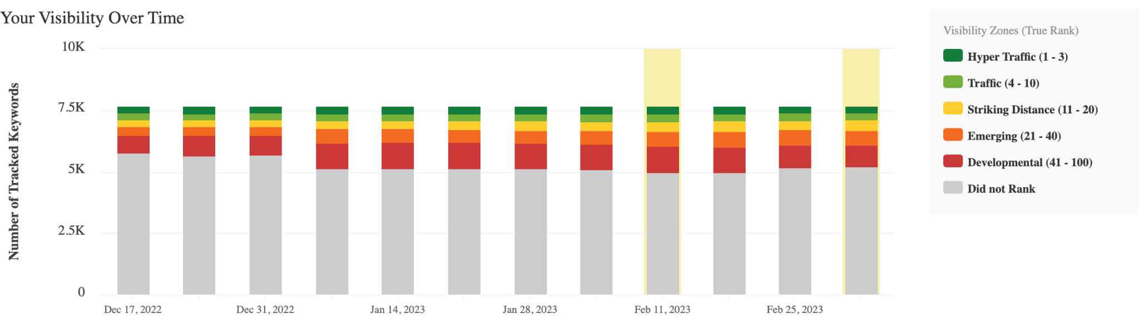
Overall SEO performance has improved
SEO performance in detail
Key Takeaways
1
Text
2
Text
Notes:
GUIDANCE
Visibility zones are great for explaining how your SEO Strategy is performing in general. It helps see bigger trends, such as for example more queries in the “Hyper Traffic” bucket and less queries in the “Did not Rank” bucket.
Check out the guide to SEO reporting here: https://www.conductor.com/academy/seo-reporting/

Slide 30
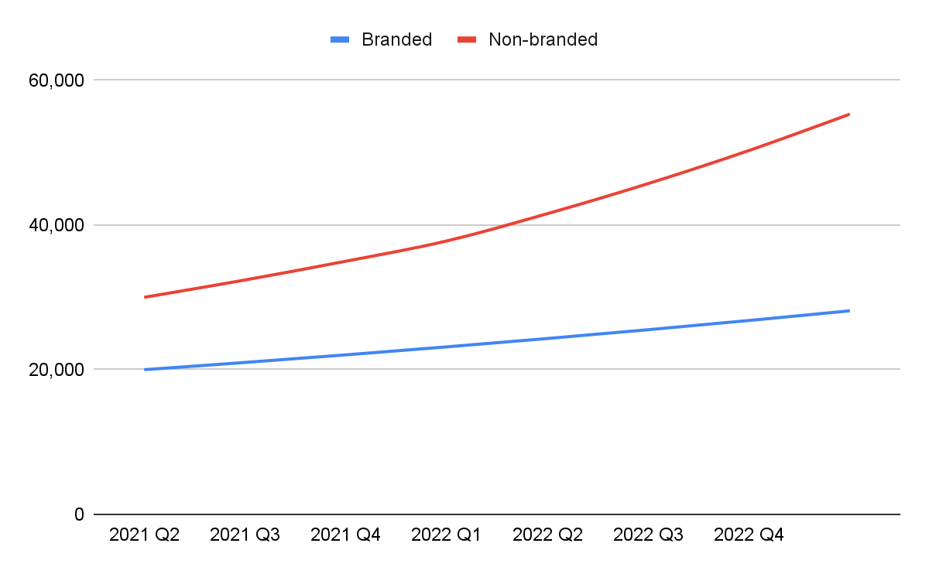
Non-branded organic traffic increased by 10%
SEO performance in detail
Key Takeaways
1
Text
2
Text
Notes:
GUIDANCE
Non-branded visitors constitute the marketing share you have in SEO. Removing branded visitors removes noise, such as when there’s big news that drives a lot of branded organic traffic.
One pragmatic way to split out organic traffic into “branded“ and “non-branded” is to identify the pages that get most (if not all) of the branded traffic, and counting all that traffic as branded traffic. That way, all the organic traffic generated to the other pages is the non-branded traffic. You can easily determine this in Google Search Console, and export that to a spreadsheet in which you keep track of the trends.
Check out the guide to SEO reporting here: https://www.conductor.com/academy/seo-reporting/

Slide 31
Dimensions to report organic results
SEO performance in detail
Key Takeaways
1
Text
The primary dimensions you report on organic search are:
1. Keyword groups (Content themes)
2. Territories
3. Funnel stages
You can go all out with this, just make sure whatever you report on makes sense for the C-suite to learn.
2
Text
Explainer slide, not meant
to be included in the final presentation.
Notes:
GUIDANCE
Track the following metrics per keyword group:
Visibility zones
Your market share
Your competitor’s market share
Check out the guide to SEO reporting here: https://www.conductor.com/academy/seo-reporting/

Slide 32
Split by keyword group
SEO performance in detail
Key Takeaways
1
Text
2
Text
Notes:
GUIDANCE
Keyword groups are essentially “content themes”. Keep in mind that you can have different competitors within each theme.
Check out the guide to SEO reporting here: https://www.conductor.com/academy/seo-reporting/

Slide 33
Split by territories
SEO performance in detail
Key Takeaways
1
Text
 | US | EMEA | Other | Total
Revenue | $3.6M | $1.55M | $0.5M | $5.65M
SQLs | 450 | 225 | 125 | 800
MQLs | 1,500 | 700 | 450 | 2,650
Visitors | 150K | 80K | 50K | 280,000
2
Text
Notes:
GUIDANCE
By splitting the organic traffic into target audiences you get a much better idea of how the channel contributes to achieving goals for that audience.
Check out the guide to SEO reporting here: https://www.conductor.com/academy/seo-reporting/

Slide 34
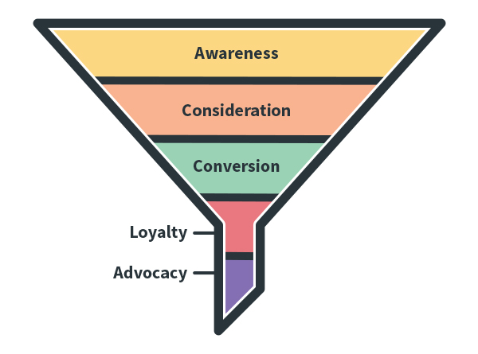
Split by funnel stage
SEO performance in detail
Key Takeaways
1
Text
Perc. of organic traffic:
60%
30%
10%
2
Text
Notes:
GUIDANCE
Explain how organic search contributes to the marketing & sales funnel.
Check out the guide to SEO reporting here: https://www.conductor.com/academy/seo-reporting/

Slide 35
Takeaways
Notes:
GUIDANCE
Now you’re going to cover the main takeaways.
Check out the guide to SEO reporting here: https://www.conductor.com/academy/seo-reporting/

Slide 36
Takeaways
We overshot our revenue goal by 13%
Revenue
$5,000,000
SQLs
750
MQLs
2,500
Visitors
250,000
Actuals
$5,650,000 (+13%)
+25% YoY
Actuals
800 (+7%)
+23% YoY
Actuals
2,650 (+6%)
+26% YoY
Actuals
280,000 (+12%)
+40% YoY
Notes:
GUIDANCE: Present the actuals and overall sentiment (Good/OK/Bad). On the next slide you’ll explain in brief why you performed the way you did.
Check out the guide to SEO reporting here: https://www.conductor.com/academy/seo-reporting/

Slide 37
Takeaways
Our performance explained
Strengths
Growth opportunities
Website migration went better than expected.
MQL to SQL conversion was higher than expected.
Total revenue exceeded expectations.
Generating enough topics to cover for next quarter.
Visitor to MQL conversion was slightly lower than expected.
Notes:
GUIDANCE: Explain the main drivers behind the performance.
Check out the guide to SEO reporting here: https://www.conductor.com/academy/seo-reporting/

Slide 38
Takeaways
Our SEO goals for QX+1 202X
Revenue
$6,000,000
SQLs
850
MQLs
3,000
Visitors
325,000
Notes:
GUIDANCE: End with the goals for the next quarter, and how you plan on achieving those goals.
Check out the guide to SEO reporting here: https://www.conductor.com/academy/seo-reporting/

Slide 39
How we will achieve our goals next quarter
Takeaways
Key Takeaways
1
Text
We will do:
x
y
z
2
Text
3
Text
Notes:
GUIDANCE: End with the goals for the next quarter, and how you plan on achieving those goals.
Check out the guide to SEO reporting here: https://www.conductor.com/academy/seo-reporting/

Slide 40
Questions?

